Slide 1
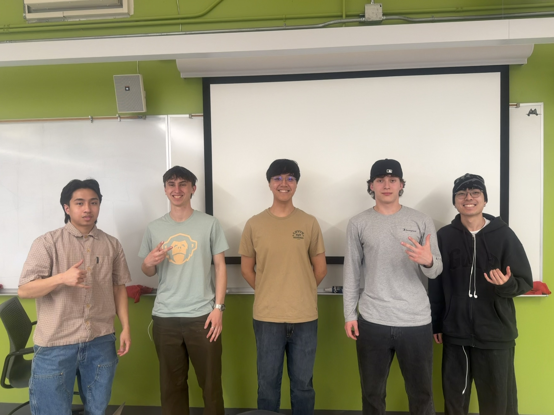
Team 203 PDR
Jairo, Calvin, Luca, Kai, Jesse

Slide 2
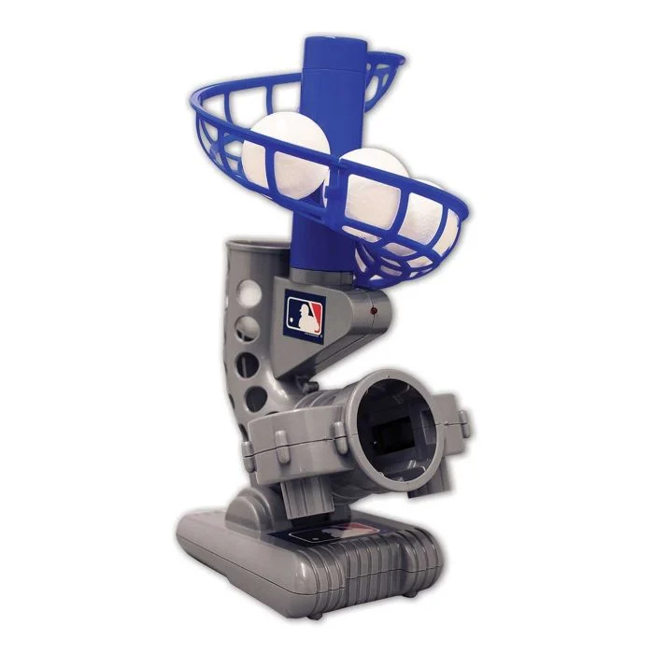

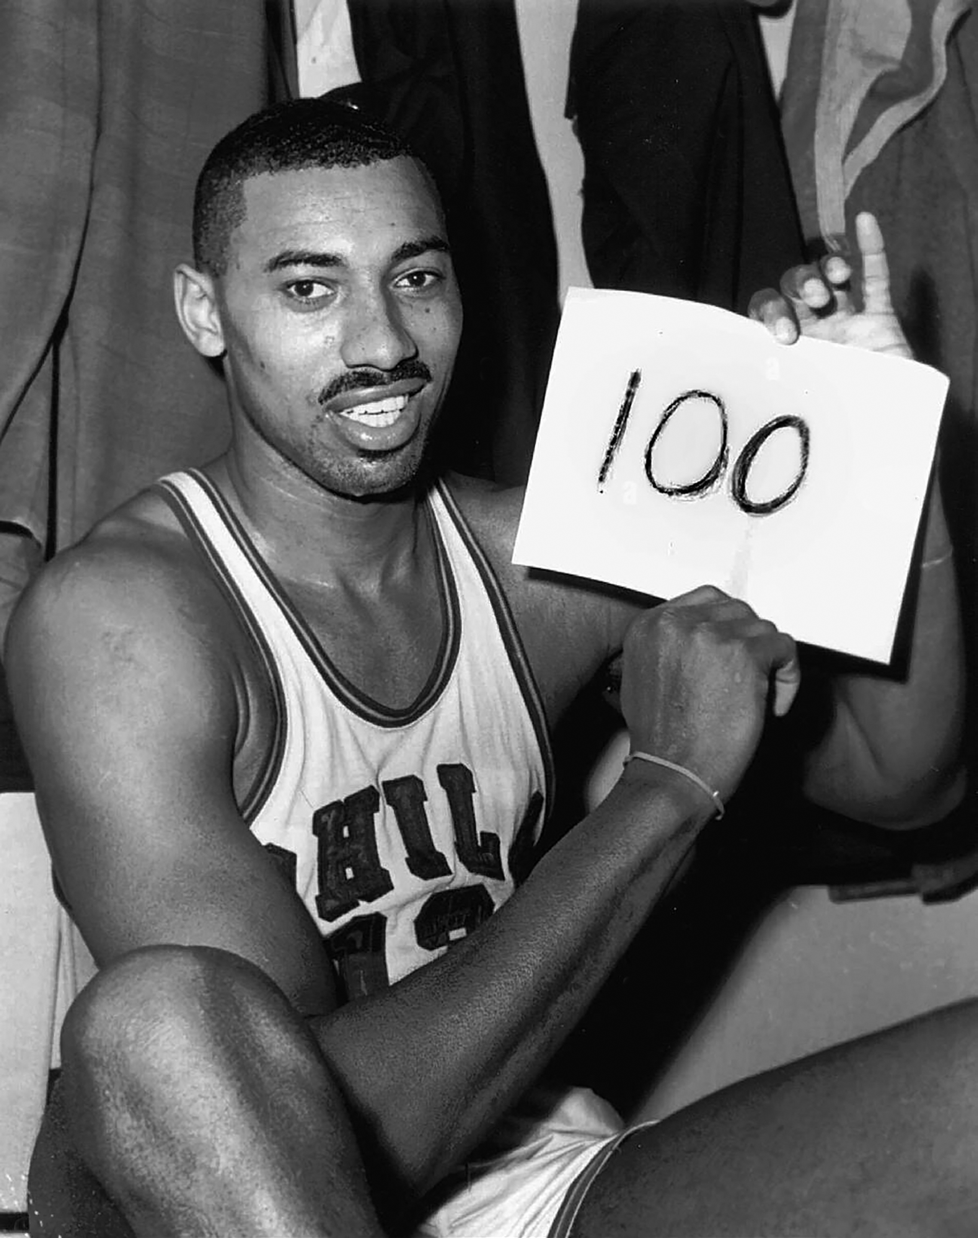

Background & Research
Market
Competition
Problem Solution
Market: Pitching Machine, Catapult, Tennis Machine, etc
Competition: Other Ball Machines, Rest of IDP
Problem Solution: 90% accuracy, multiple loading capacity, score a lot of points, easy to reload, 100 point goal
Notes:
Our project focuses on the market of ball-launching systems, which include pitching machines, tennis ball machines, and catapult style launchers. These systems are widely used in sports training environments to provide consistent, repeatable ball delivery for skill development.
Through our research, we found that existing machines perform well in isolated areas, such as speed or spin control, but often fall short in overall usability. The main limitations we found were limited capacity which required frequent reloading, and a high energy generation need.
In terms of competition, we are not only comparing ourselves to commercial ball machines, but also to other teams in the IDP course who are developing similar launching machines. This creates a need for our design to stand out in performance.
Based on this research, we identified some goals: a system with high accuracy, capacity for multiple beanbag loading, fast reload time, and a scoring goal of 100 points. These goals are what drove the inspiration for our design process.

Slide 3
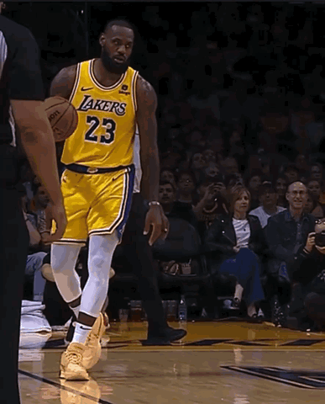
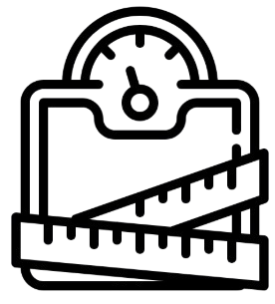
Project Attributes
Efficiency
Cost
Notes:
Achieve the highest amount of points
Create a product that is cost-efficient
Competition
Accuracy
Weight limit
Can't damage the floor
Within the constraints how can we get the job done

Slide 4
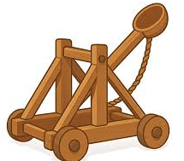
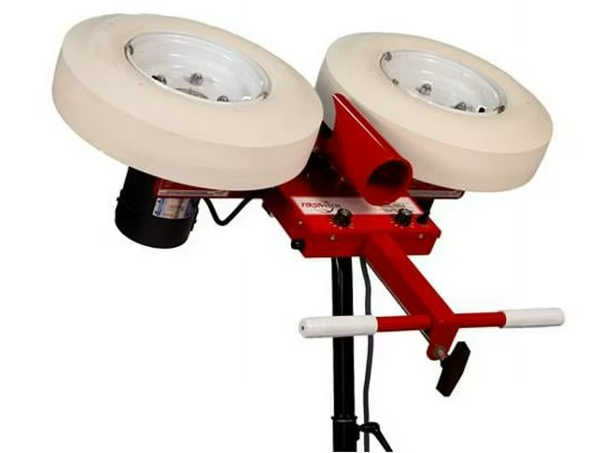
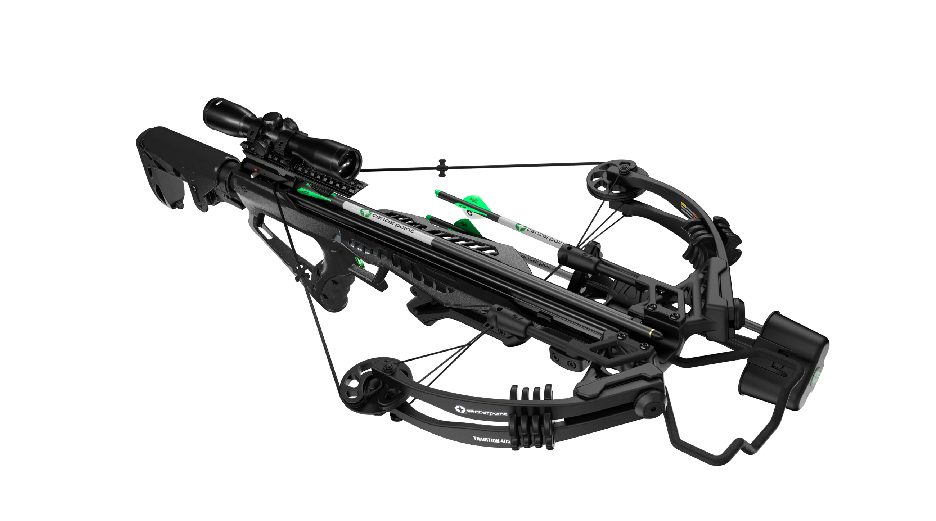
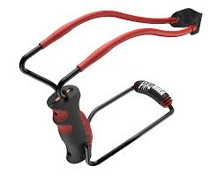
Concepts Considered
Catapult
Flywheel
Slingshot
Bow and arrow & Crossbow
Notes:
During the early design phase, our team explored several different ball-launching mechanisms, each with advantages and limitations. The four primary concepts we considered were a catapult, a flywheel-based pitching machine, a slingshot, and a crossbow.
The catapult uses a lever arm and stored potential energy to launch the ball. This design is relatively simple to construct, but our main concerns were with difficulty in being consistent, and a slow reload time and only being able to launch one beanbag at a time.
The slingshot relies on elastic bands to store and release energy. The design is also very simple, however, due to it being mostly human operated, there were concerns with a lack of accuracy and repeatability.
The pitching machine uses flywheels to quickly accelerate and launch the ball. The design offers high repeatability, quick reload, and control over launch angle. However, we believe that the energy generation needed to power the flywheels is not feasible given our project constraints.
The crossbow uses a guided track and tensioned string system to propel the beanbag. The design features a high repeatability and accuracy due to the string being pulled back to the same place every single launch. We also found that there is room for multiple beanbag loading if designed correctly.

Slide 5
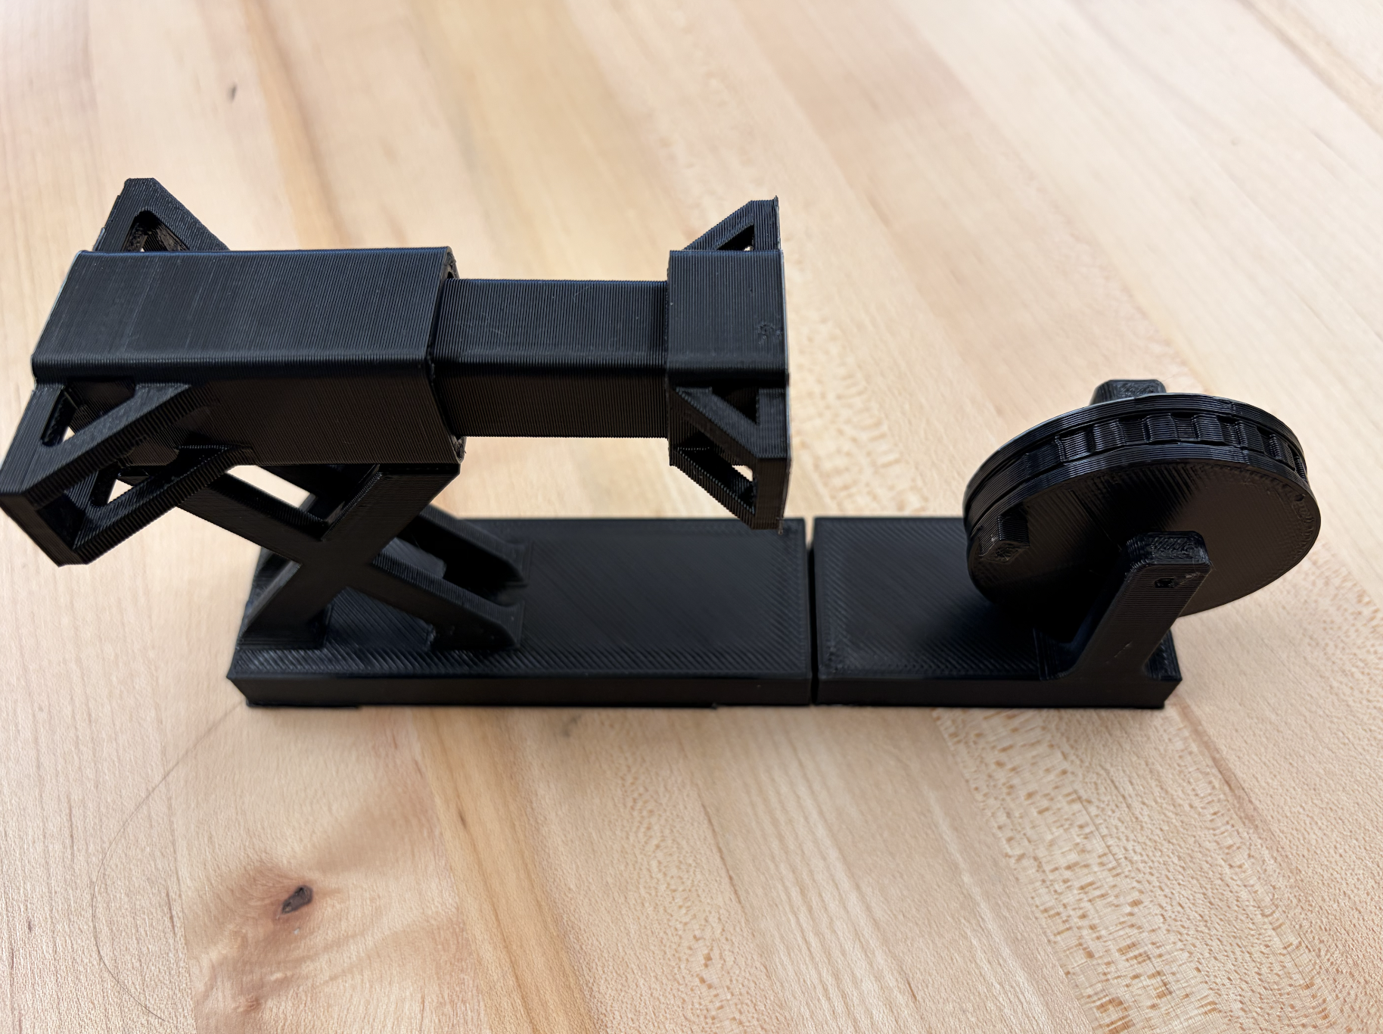
Chosen Concept
Store energy with bungee cords
Hand crank for drawing back piston
Trigger mechanism to release energy
Hook
Kg
Weighted seesaw
Trigger
Notes:
Inspiration from crossbow
Two components barrel and piston
3 bean bags loaded into barrel
Bungee cords to store energy
Hand crank to draw back piston
Seesaw trigger mechanism

Slide 6
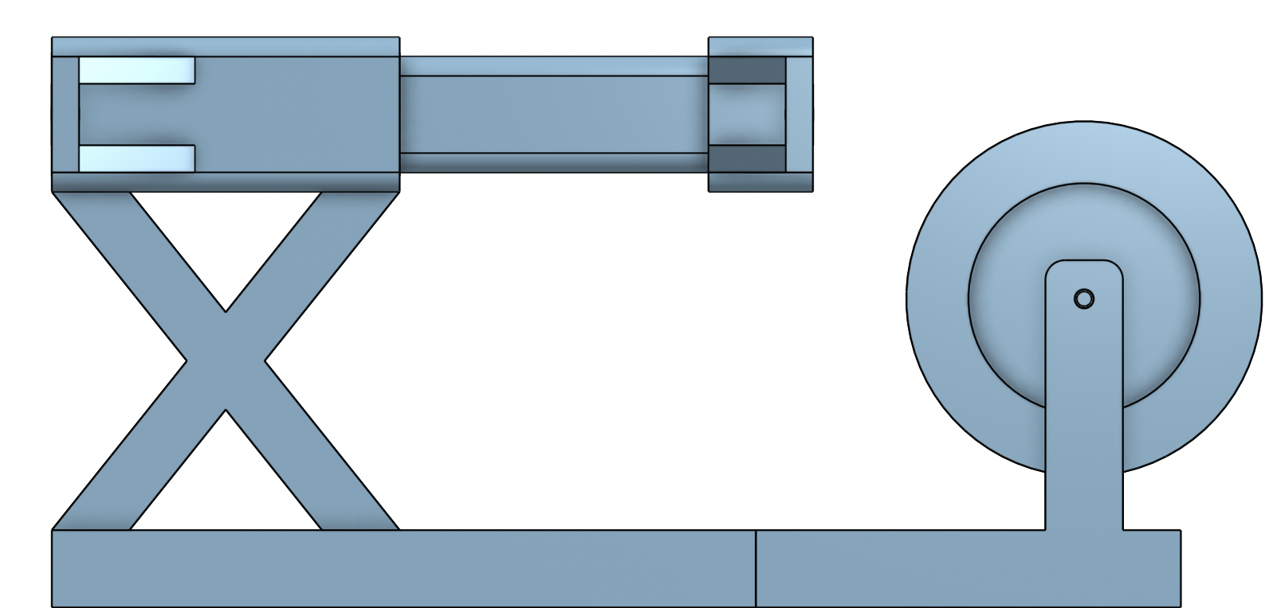
Chosen Concept
Notes:
-two planes with hinge at end to vary angle
-guided rails to be precise about angle

Slide 7
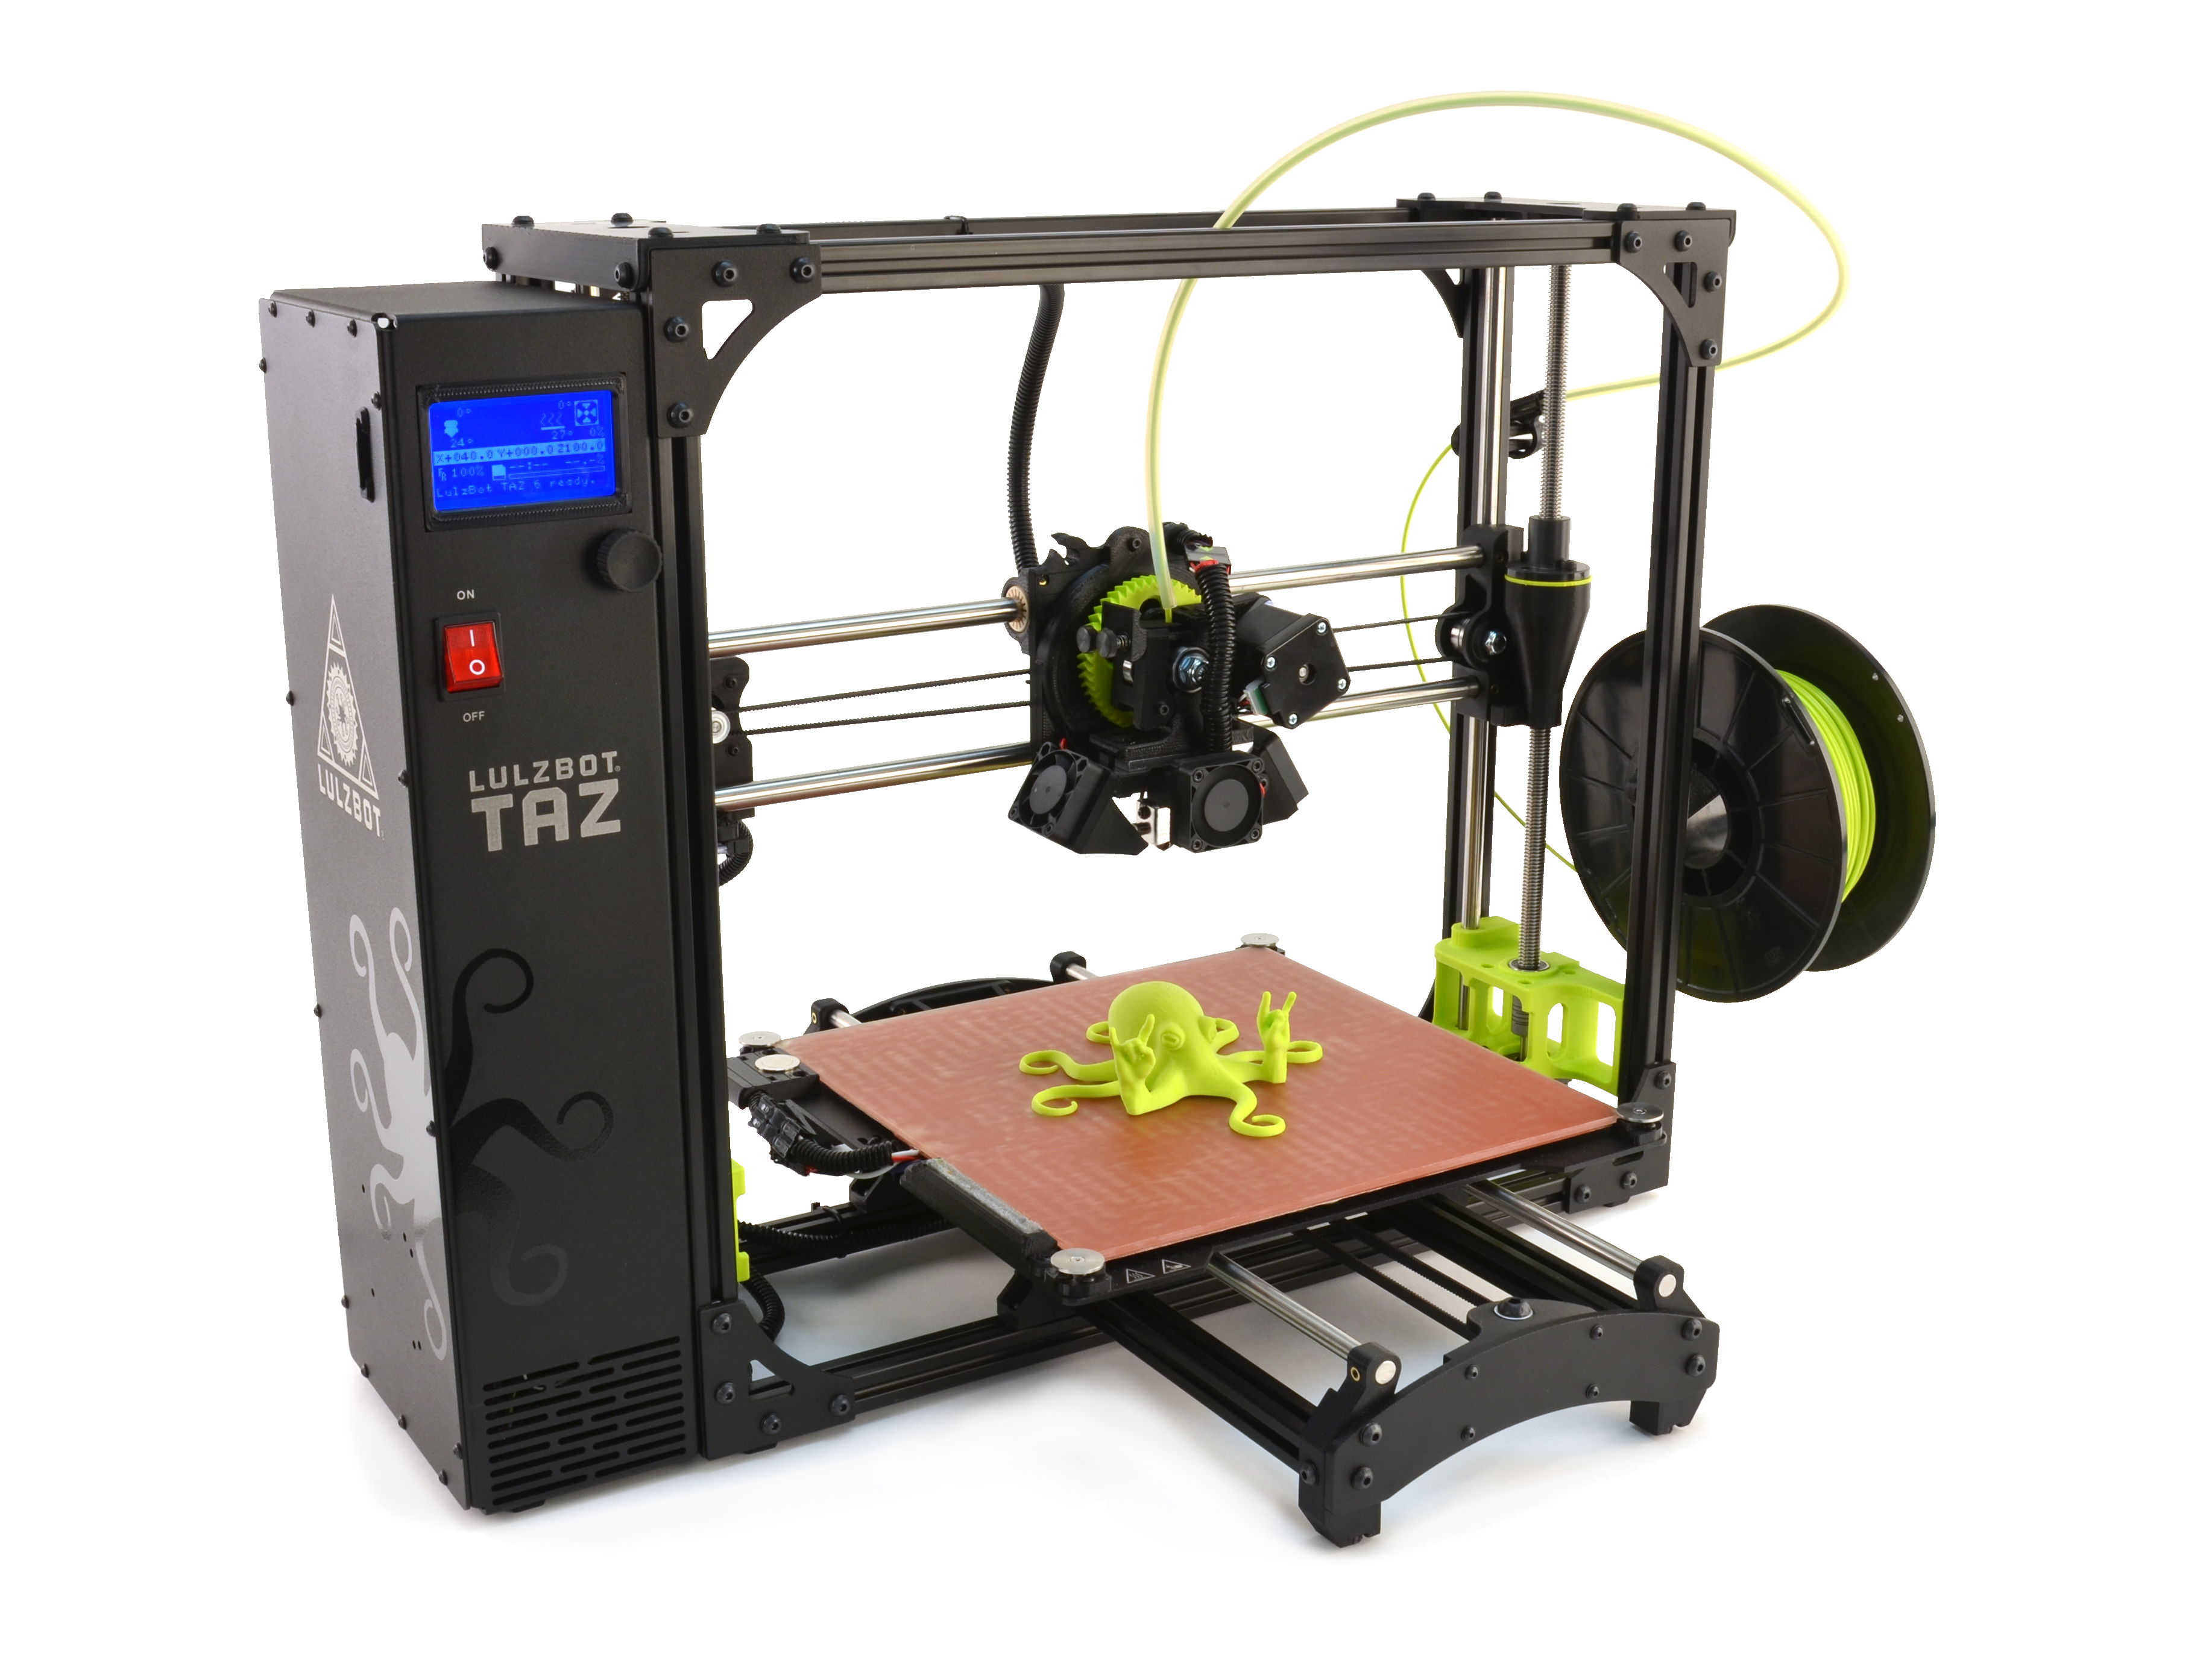
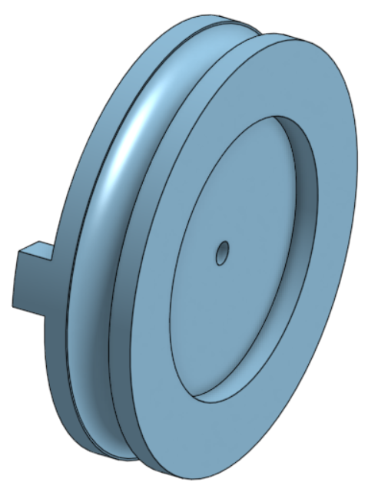
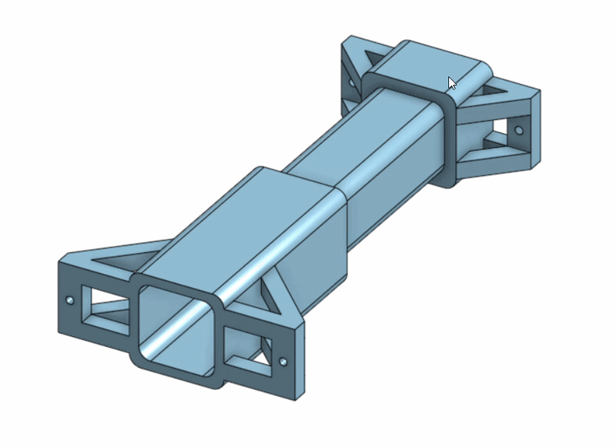
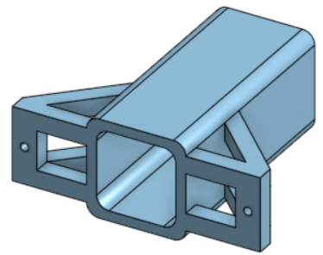
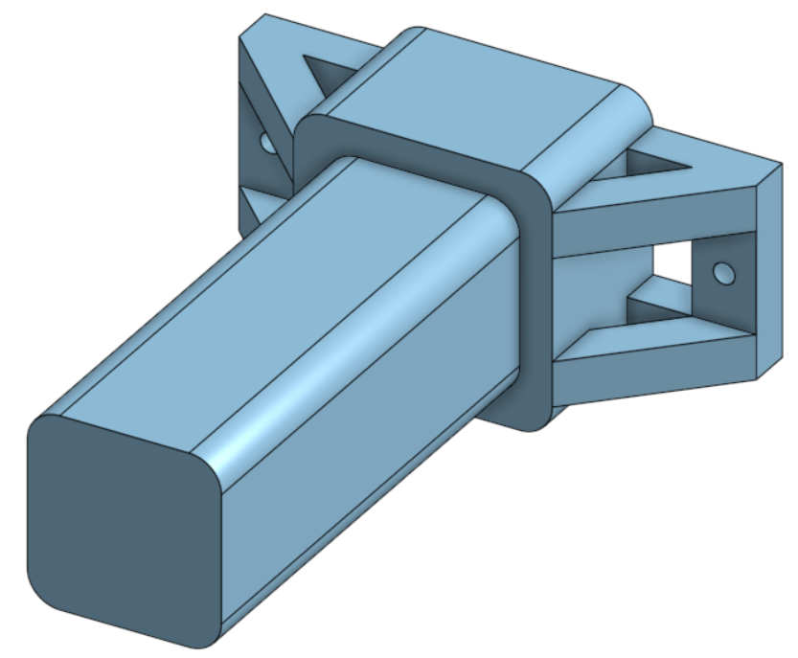
Selection Rationale
Repeatability
Manufacturability
Notes:
Repeatability
Reload time
Manufacturability
# of components
Simple shapes
Off-the-shelf materials

Slide 8
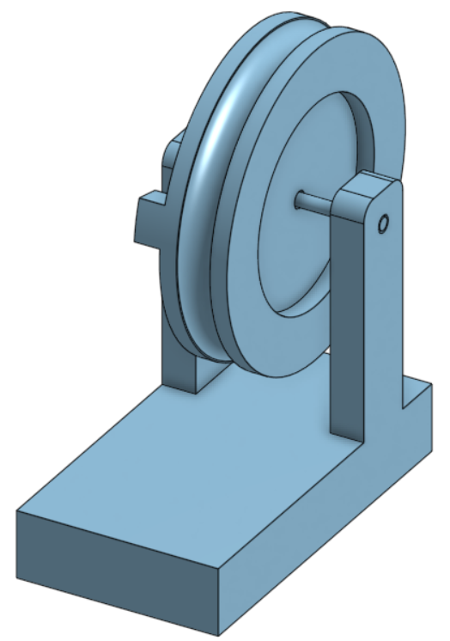
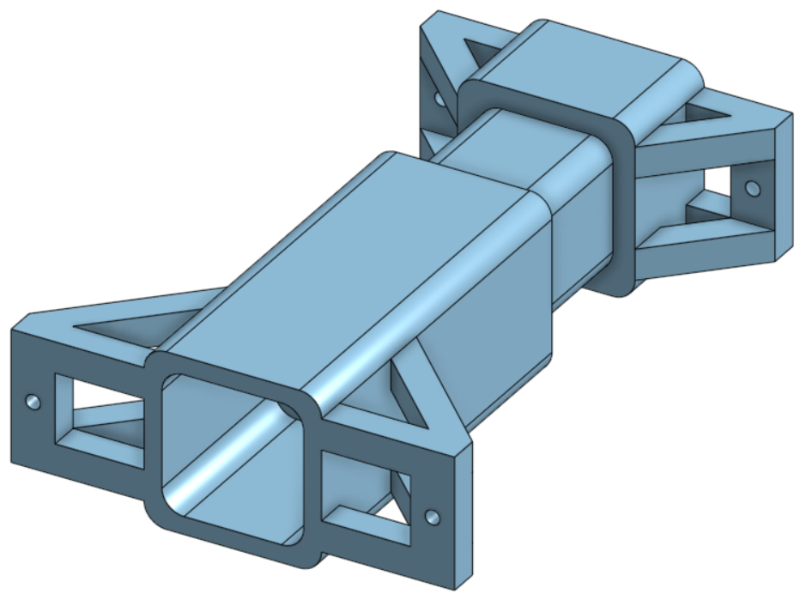
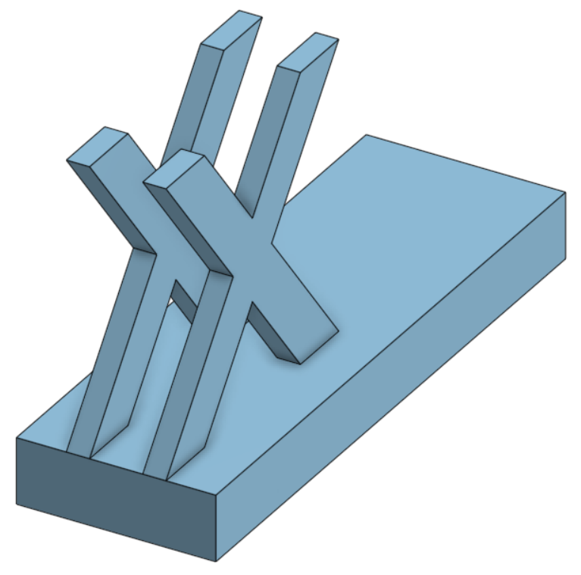
Plan for Phase 2
Notes:
Sub-systems considered
Launch mechanism
Chassis/platform

Slide 9
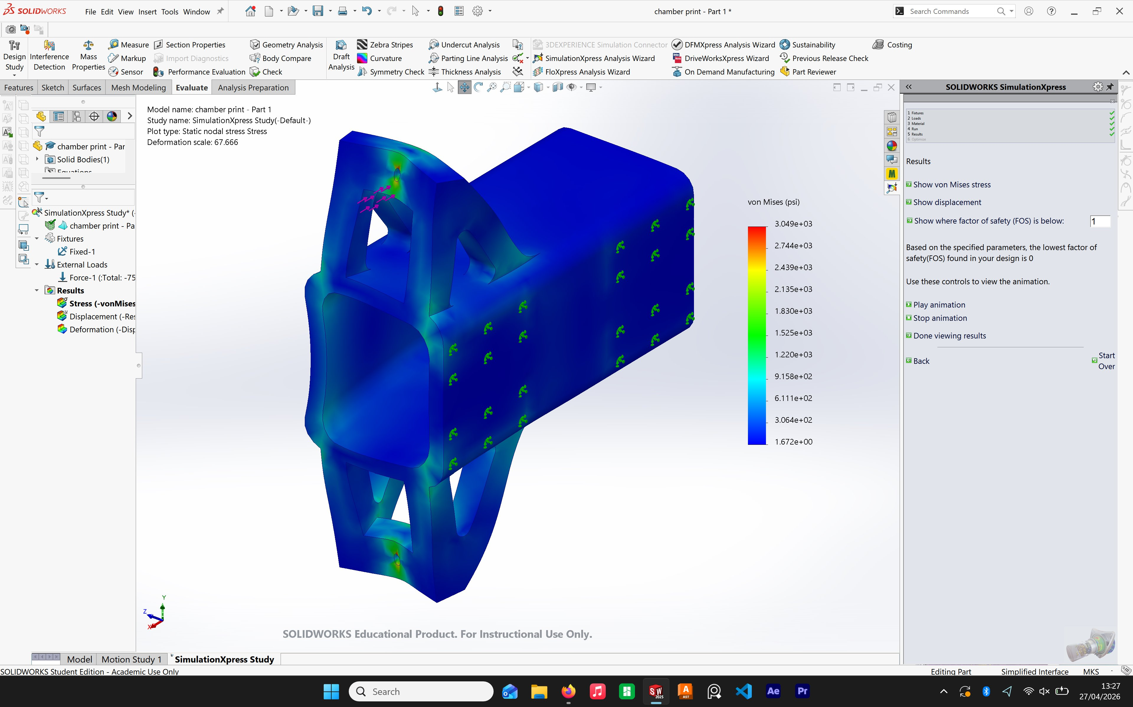

Slide 10
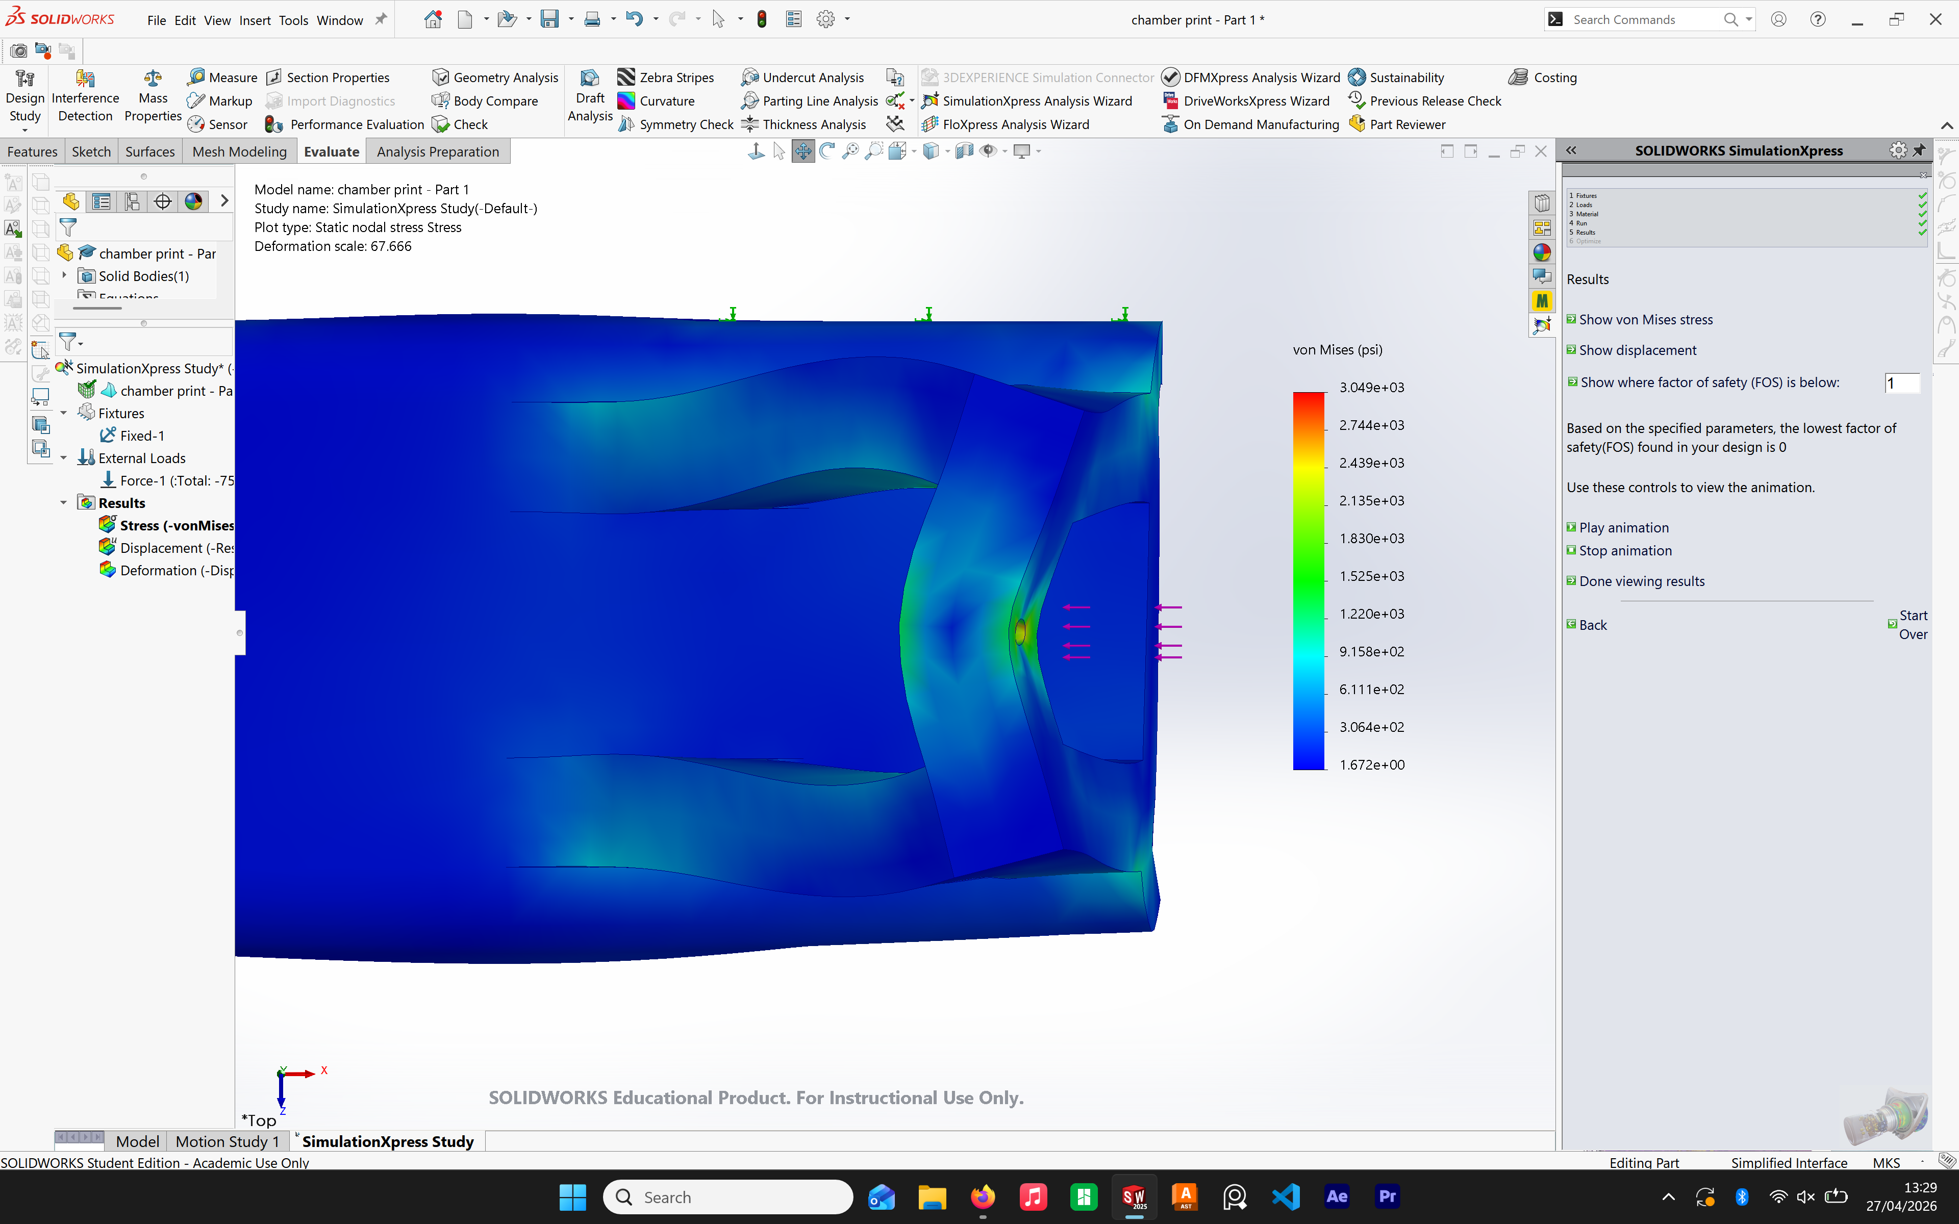

Slide 11
Primary Changes

Slide 12
Do we want to use a crank? Slider instead?
Should base be one piece and crank mounts to it? Modularity?
Will channel account for multiple rotations of rope?

Slide 13
How can we make system have adjustable angle / height?
Scissor jack mechanism?
How to we ensure strength at all angles of input force? (Especially with crank)

Slide 14
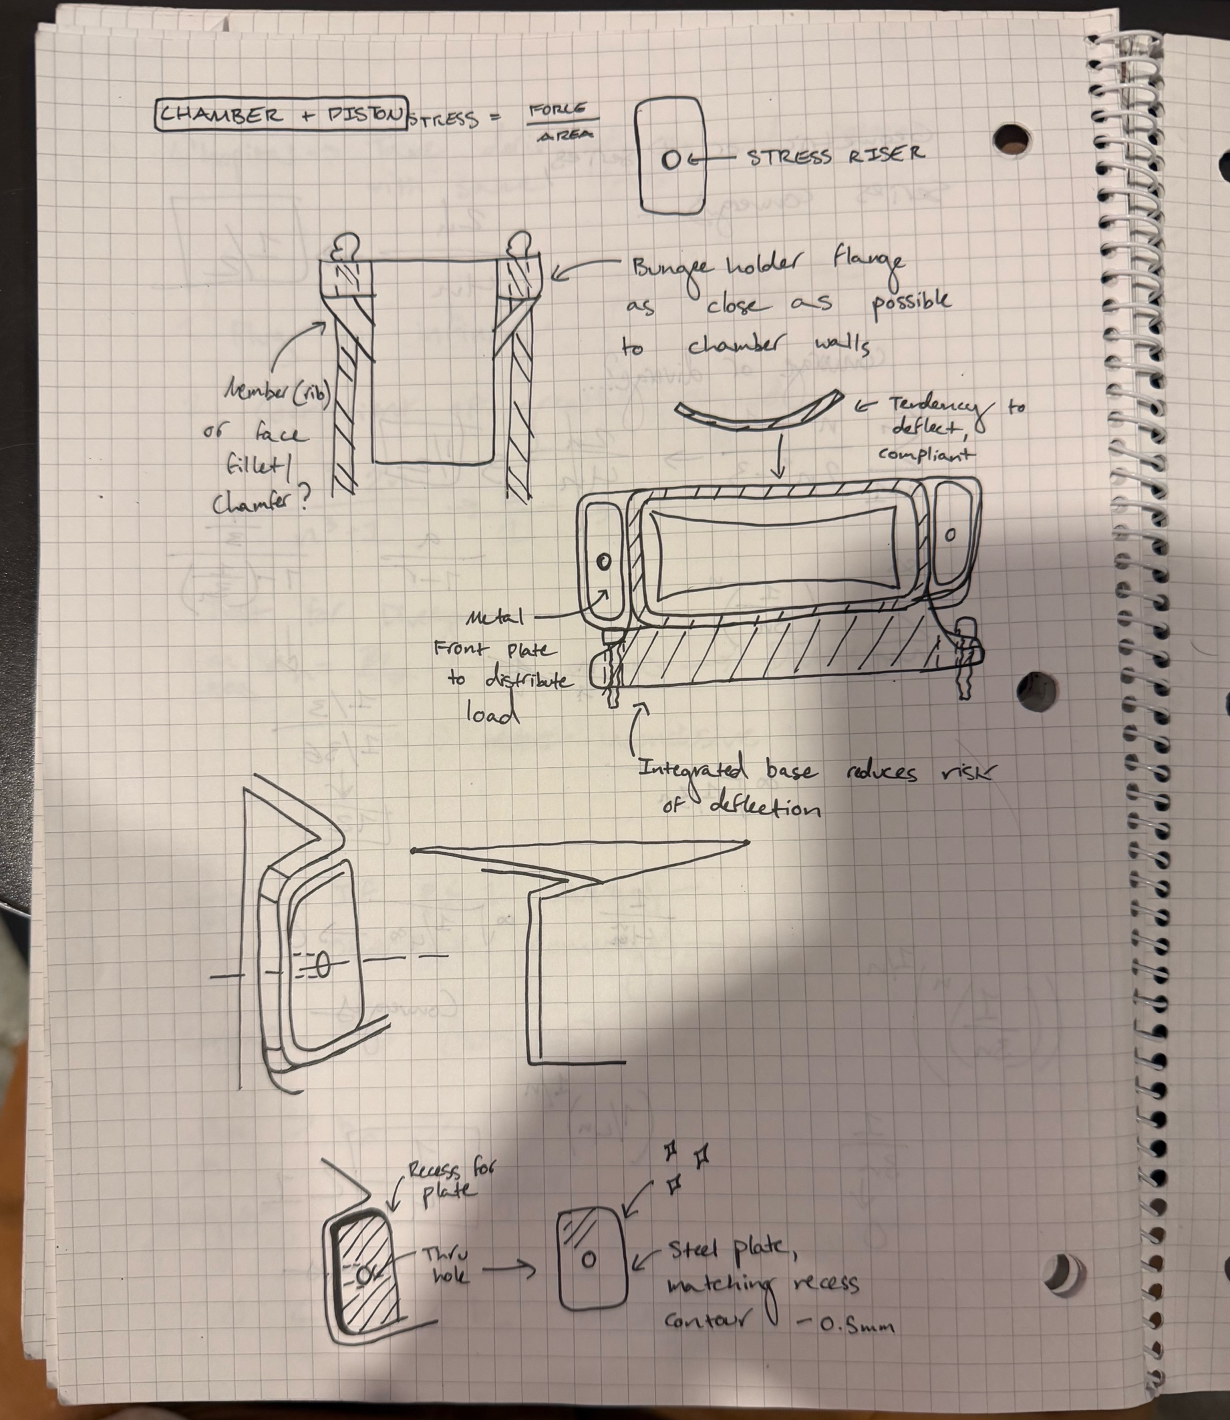
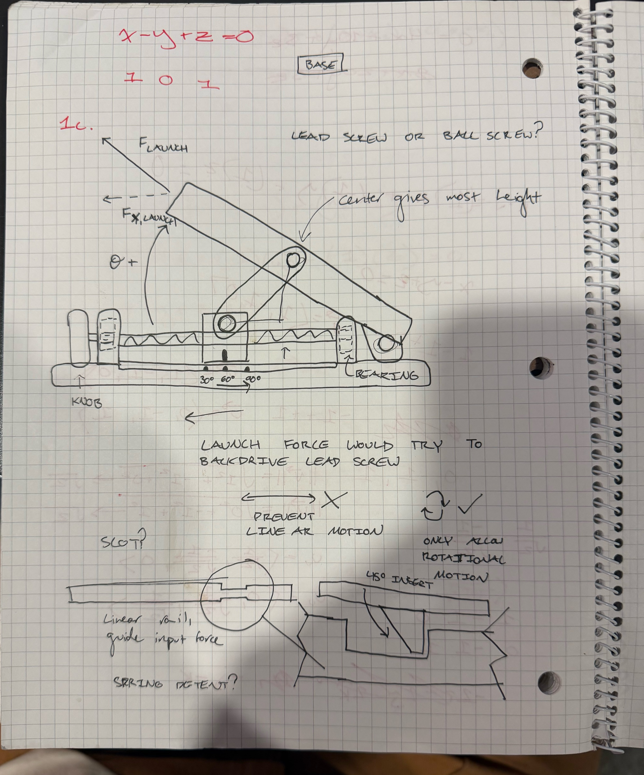
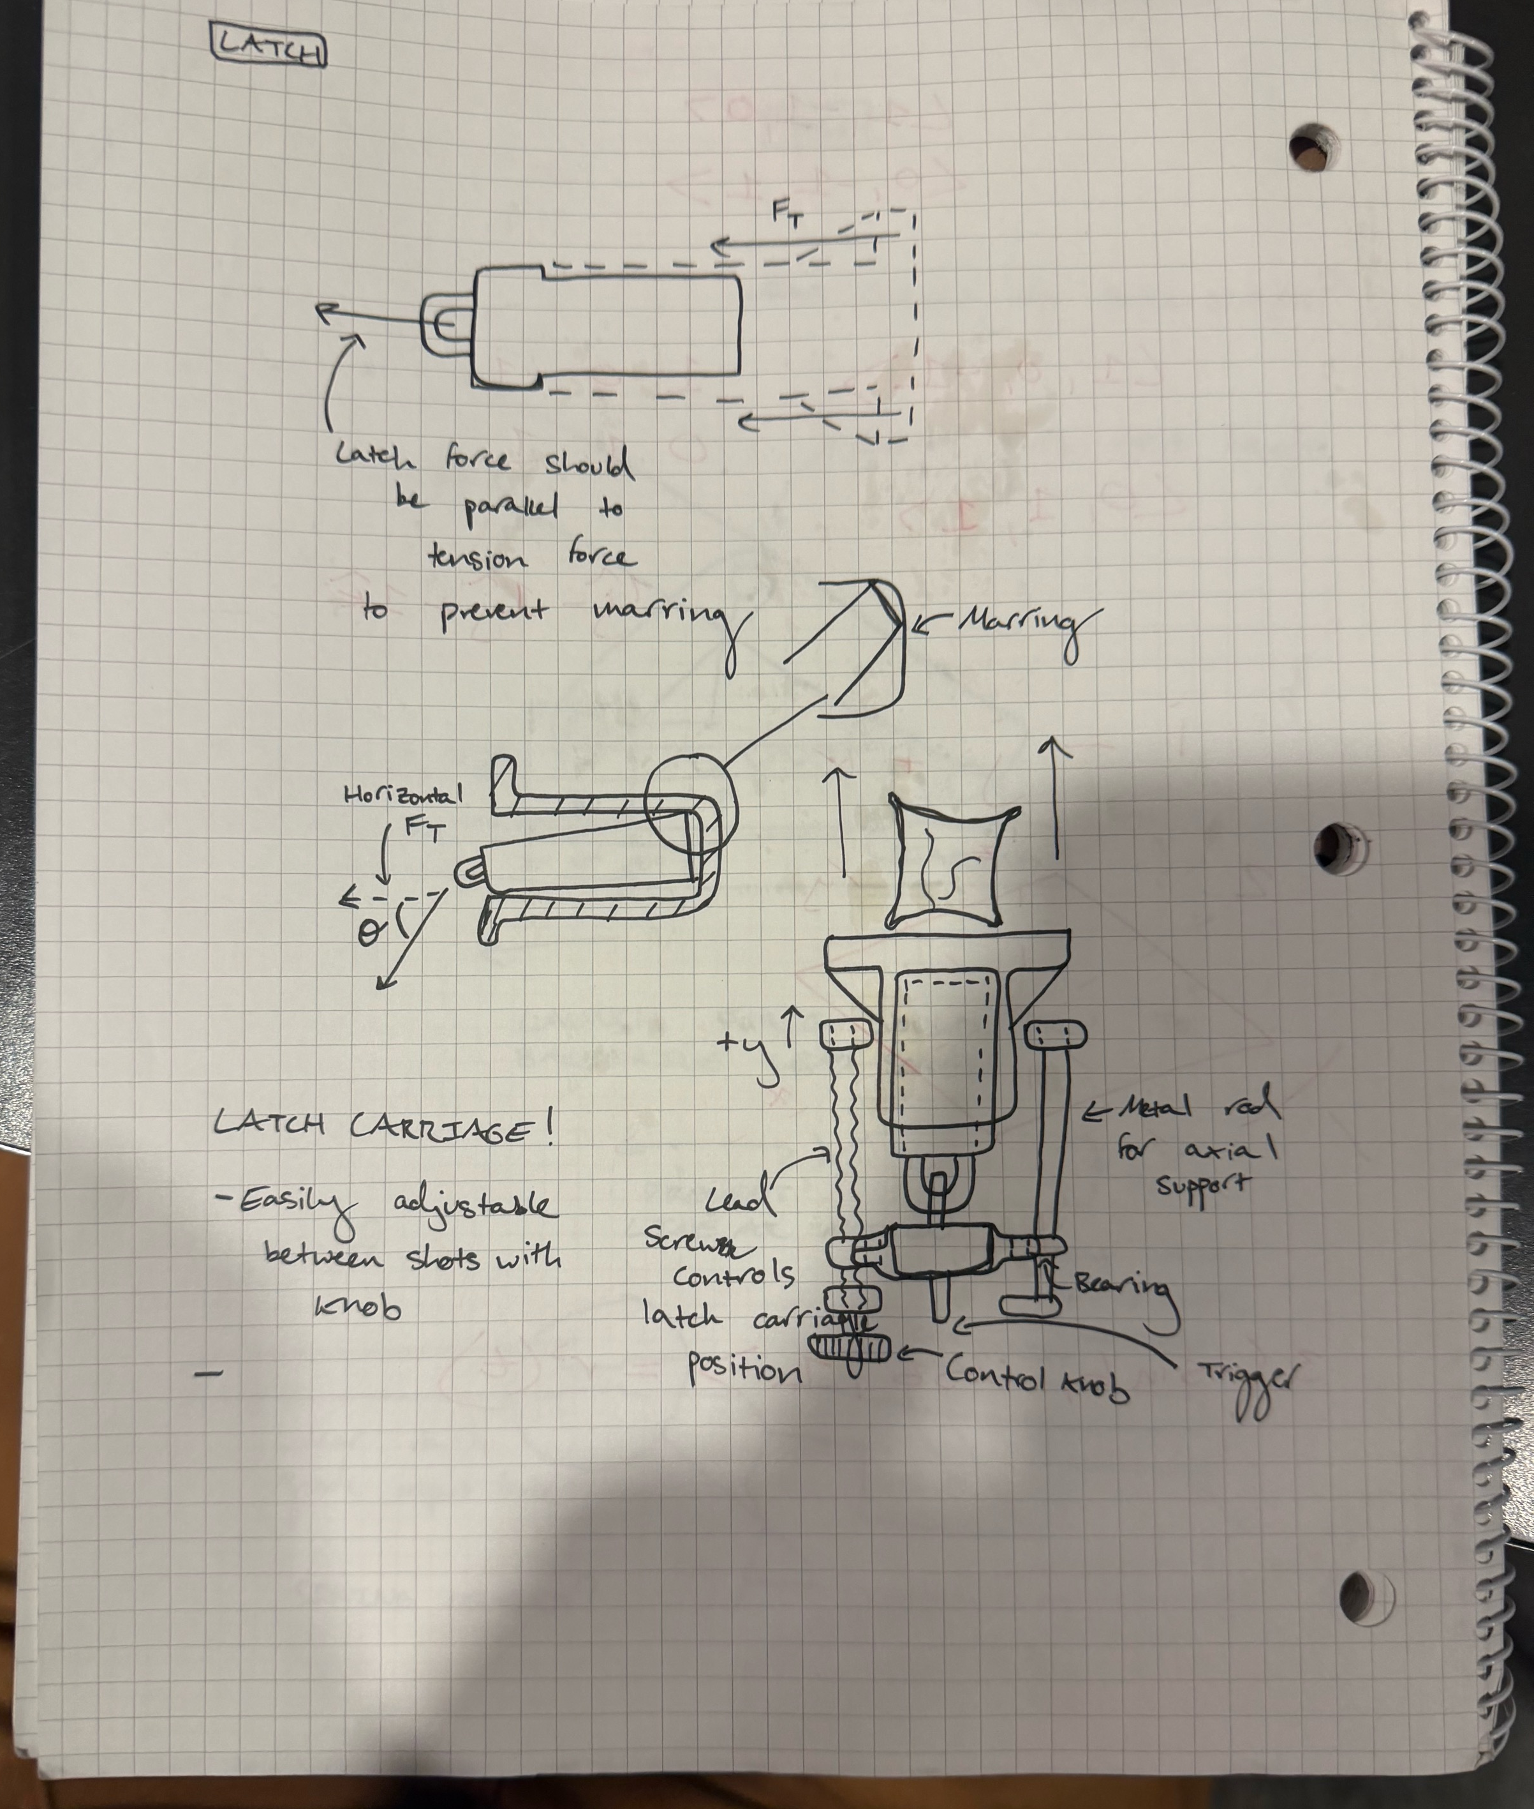

Slide 15
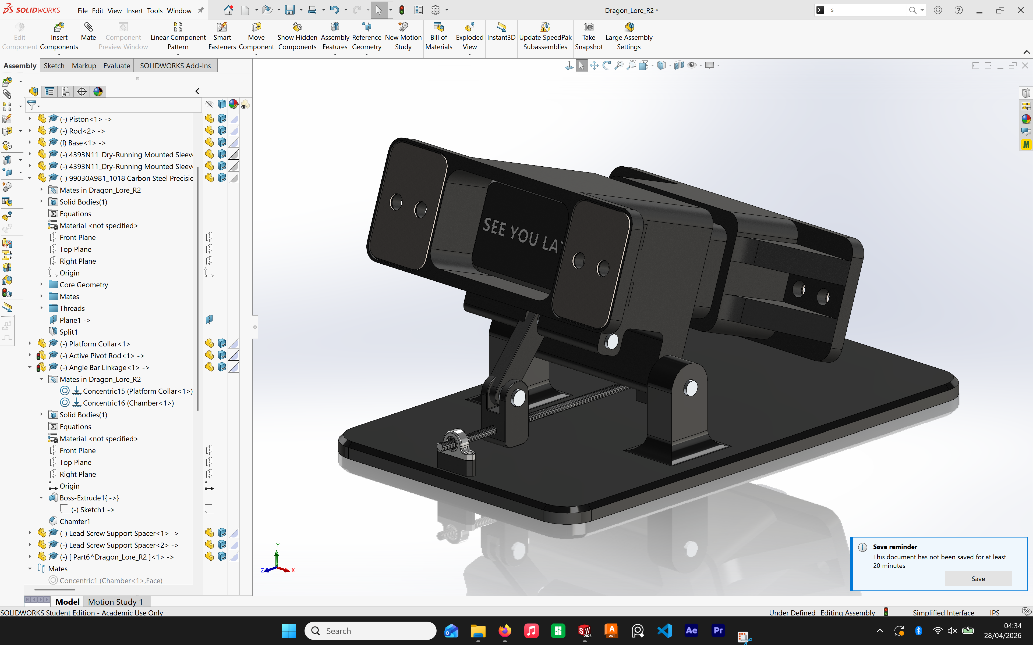

Slide 16
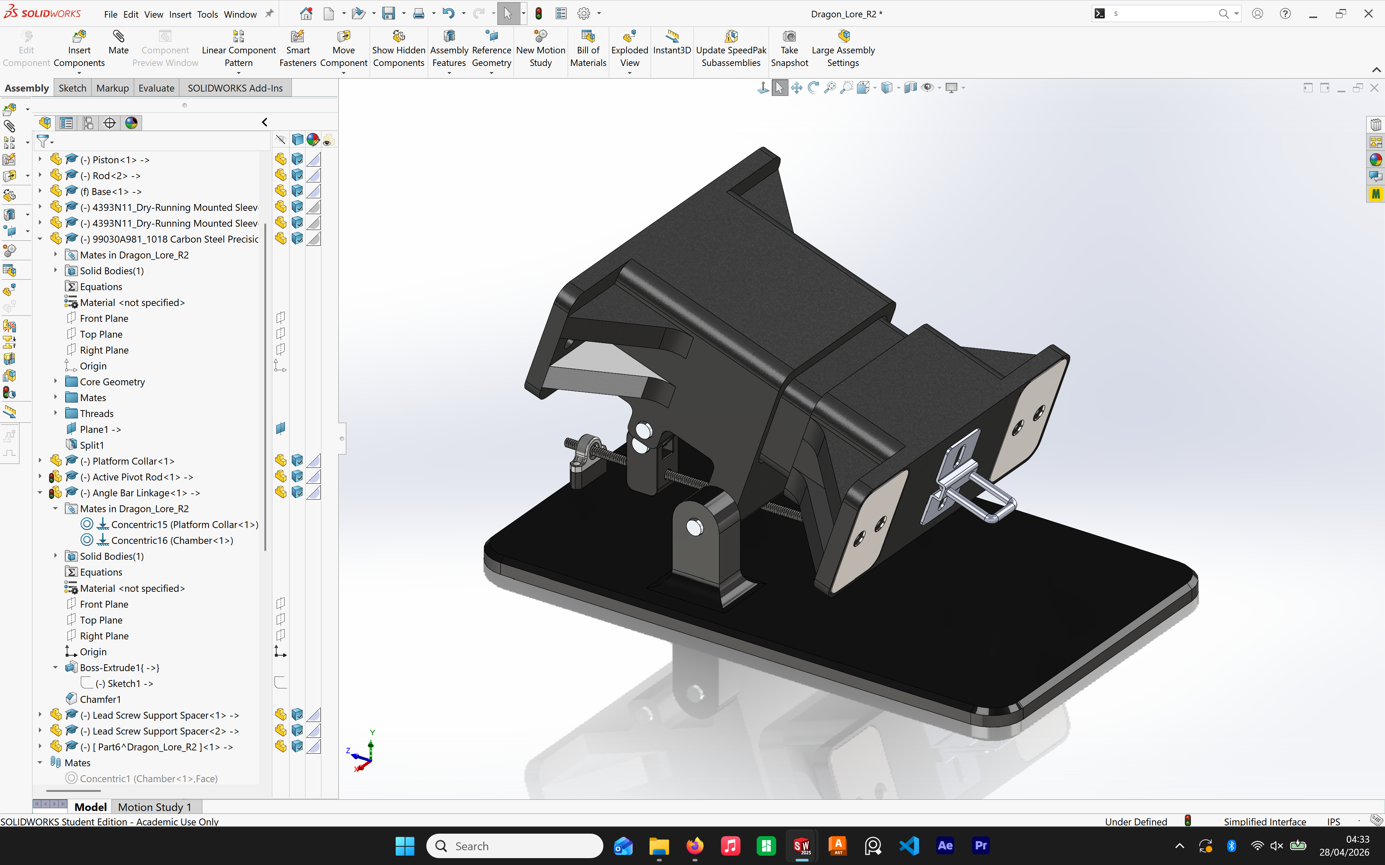

Slide 17
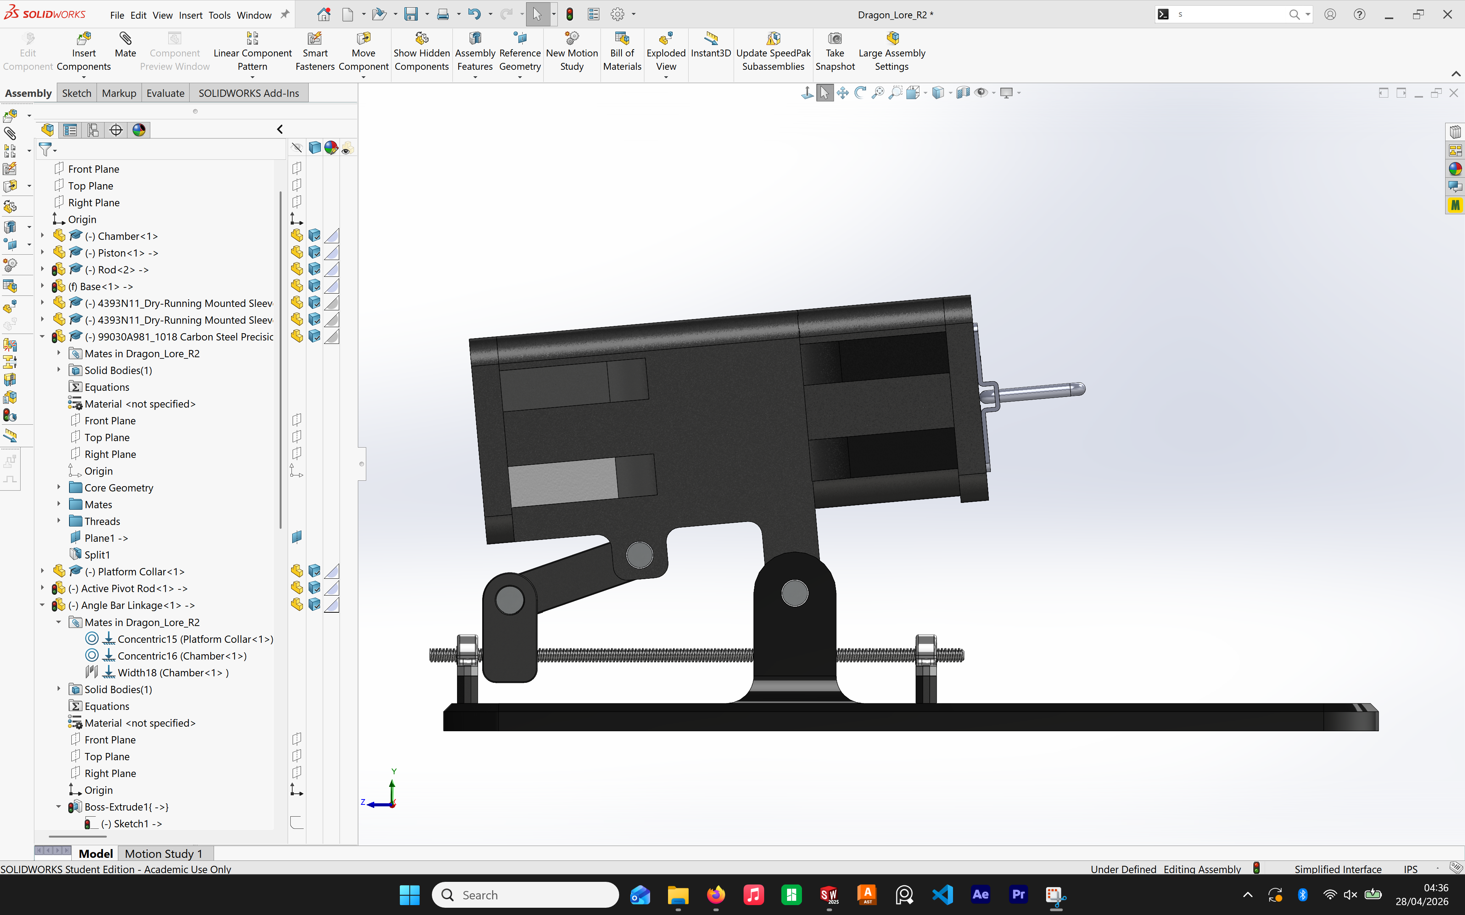
MINIMUM ANGLE CONDITION

Slide 18
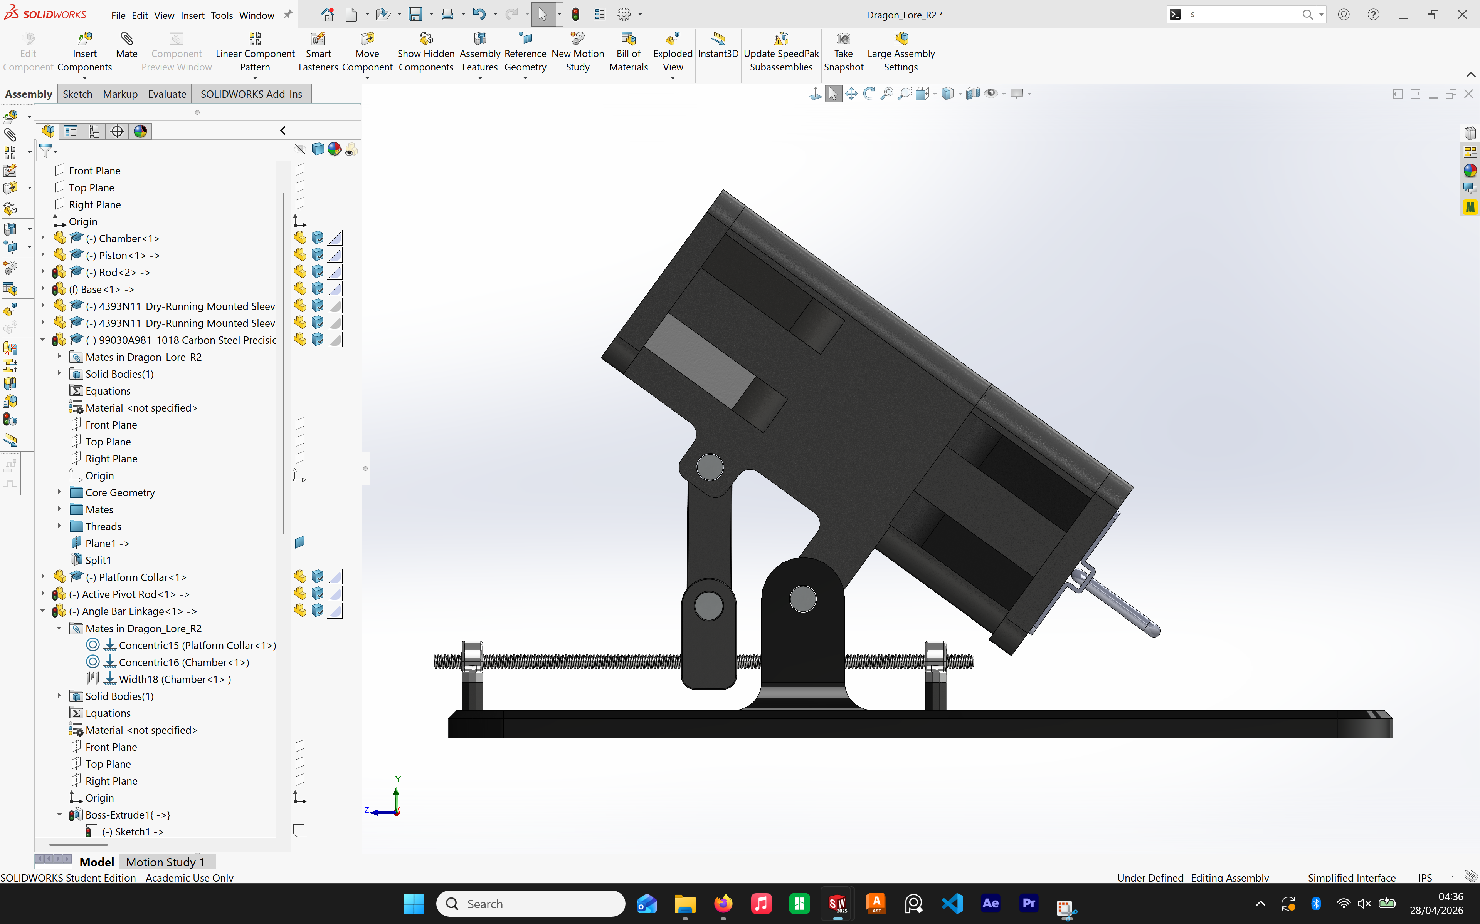
MAXIMUM ANGLE CONDITION

Slide 19
Thank you

