Slide 1

CRITICAL design review
Team 203: Jairo, Calvin, Kai, Luca, Jesse

Slide 2
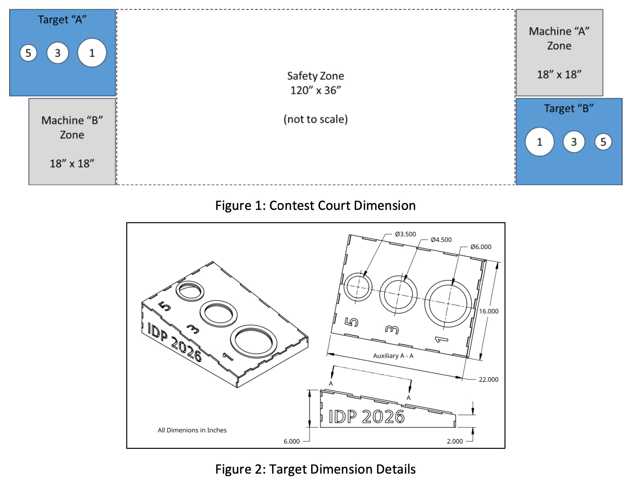
Problem SUMMARY
CHALLENGE
REQUIREMENTS
OBJECTIVES
Notes:
Our project challenge is to design a system capable of accurately launching beanbags into target holes from a distance of 10 feet.
The launcher must:
Achieve consistent accuracy
Be easy to reload
Safely store and release energy
And score efficiently during competition conditions
As we discussed during the PDR, our team established clear performance goals of achieving 90% accuracy and scoring 100 points during competition. Since then, we have continued developing our design with these objectives in mind.
We have refined our design, built and tested a prototype, and analyzed several key engineering challenges that emerged throughout the development process.
Today's presentation will focus on these developments and outline our plan for completing the final design.

Slide 3
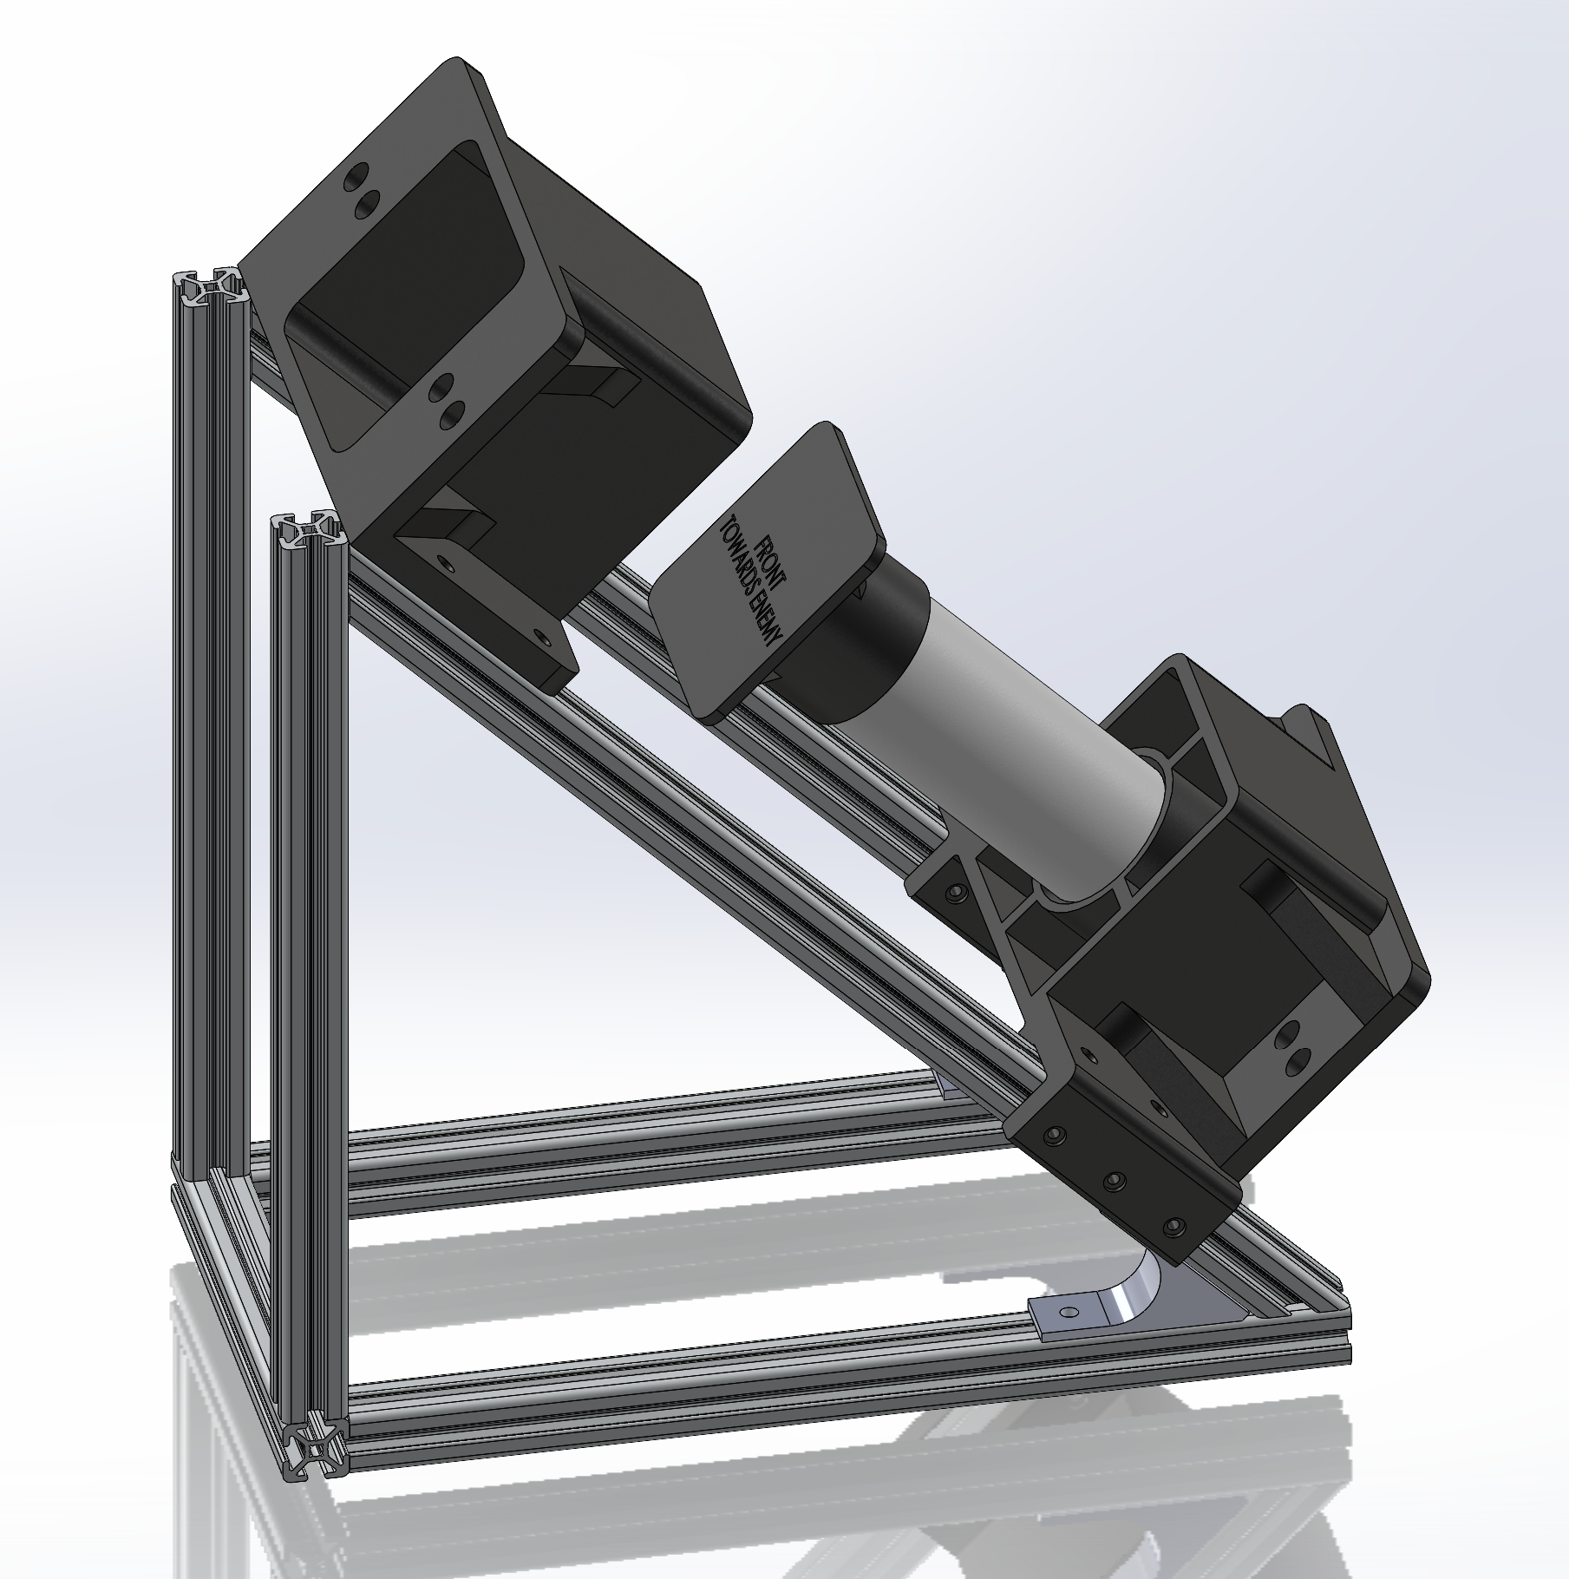
Overall Design Details
Project Attributes
Chosen Concept
Selection Rationale
Notes:
Project Attributes
- Accuracy
Precision
Shot Efficiency
Chosen Concept
Piston
Chamber
Base
Selection Rationale
Repeatability
Manufacturability

Slide 4
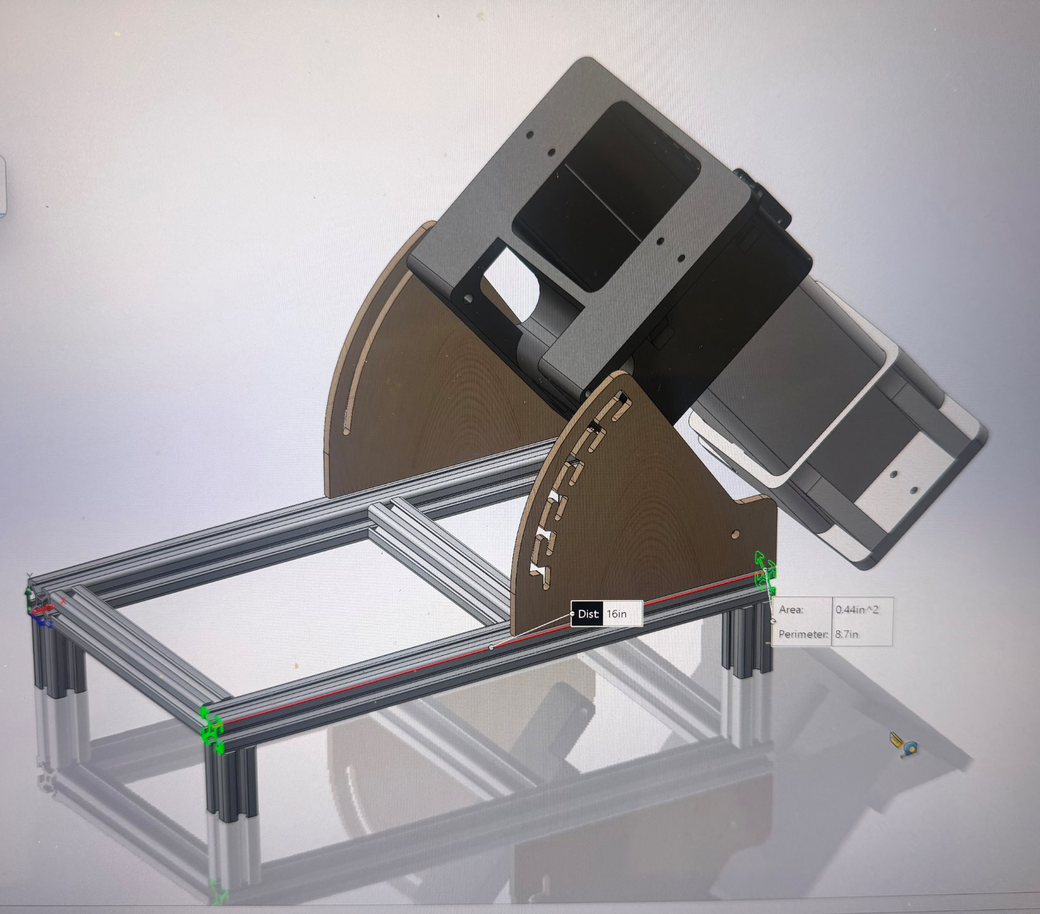
INITIAL DESIGN
Notes:
Before discussing our detailed analysis, we wanted to show our original design concept and explain how the design evolved.
Our initial concept consisted of four major components: a large base platform, an adjustable angle mount, a spring-loaded ratchet trigger mechanism, and a chamber and piston assembly mounted at the rear of the launcher.
The idea behind this concept was to maximize adjustability. The launch angle could be changed independently, and the piston stroke distance could also be varied to control launch force.

Slide 5
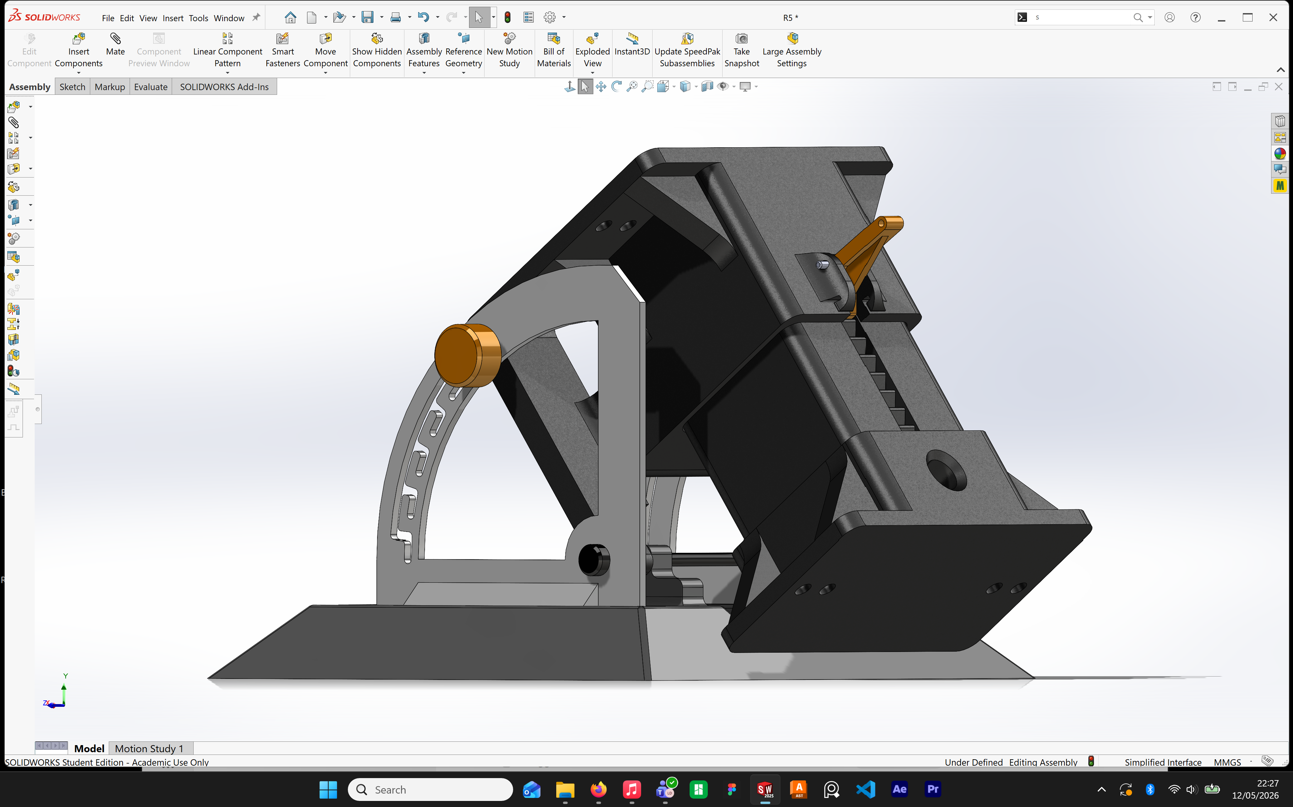
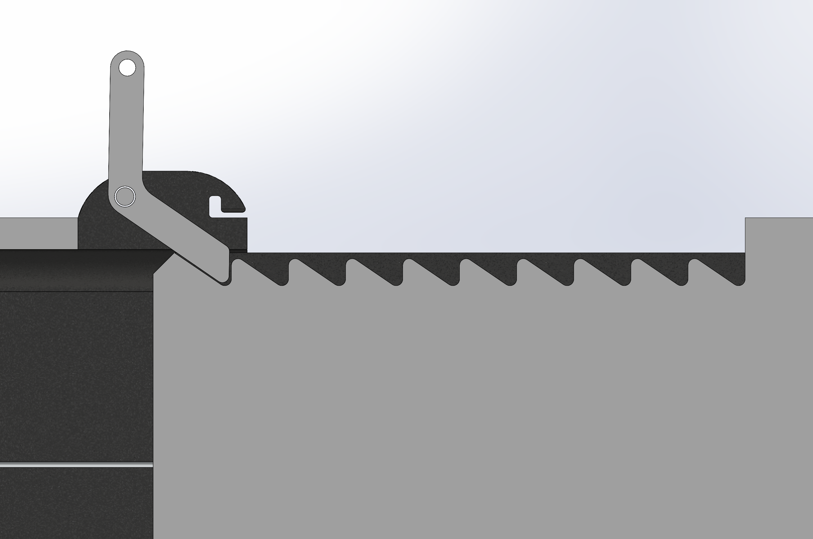
INITIAL DESIGN DETAILS
PROS
High precision
Highly repeatable
CONS
Redundant
Complex
Issues with launch stroke
Notes:
There were several advantages to this design. First, it offered very high precision because both angle and launch force could be adjusted. Second, the crossbow-style launch mechanism provided high repeatability.
However, during prototyping and testing, we identified several significant issues.
The design was more complicated than necessary because both launch angle and stroke distance could be adjusted, creating redundant control variables.
We experienced excessive friction between the piston and chamber walls, which reduced efficiency. The piston motion was also not perfectly linear, leading to alignment problems. Additionally, the ratchet trigger mechanism failed under higher loads.
These challenges motivated a redesign of several major subsystems.

Slide 6
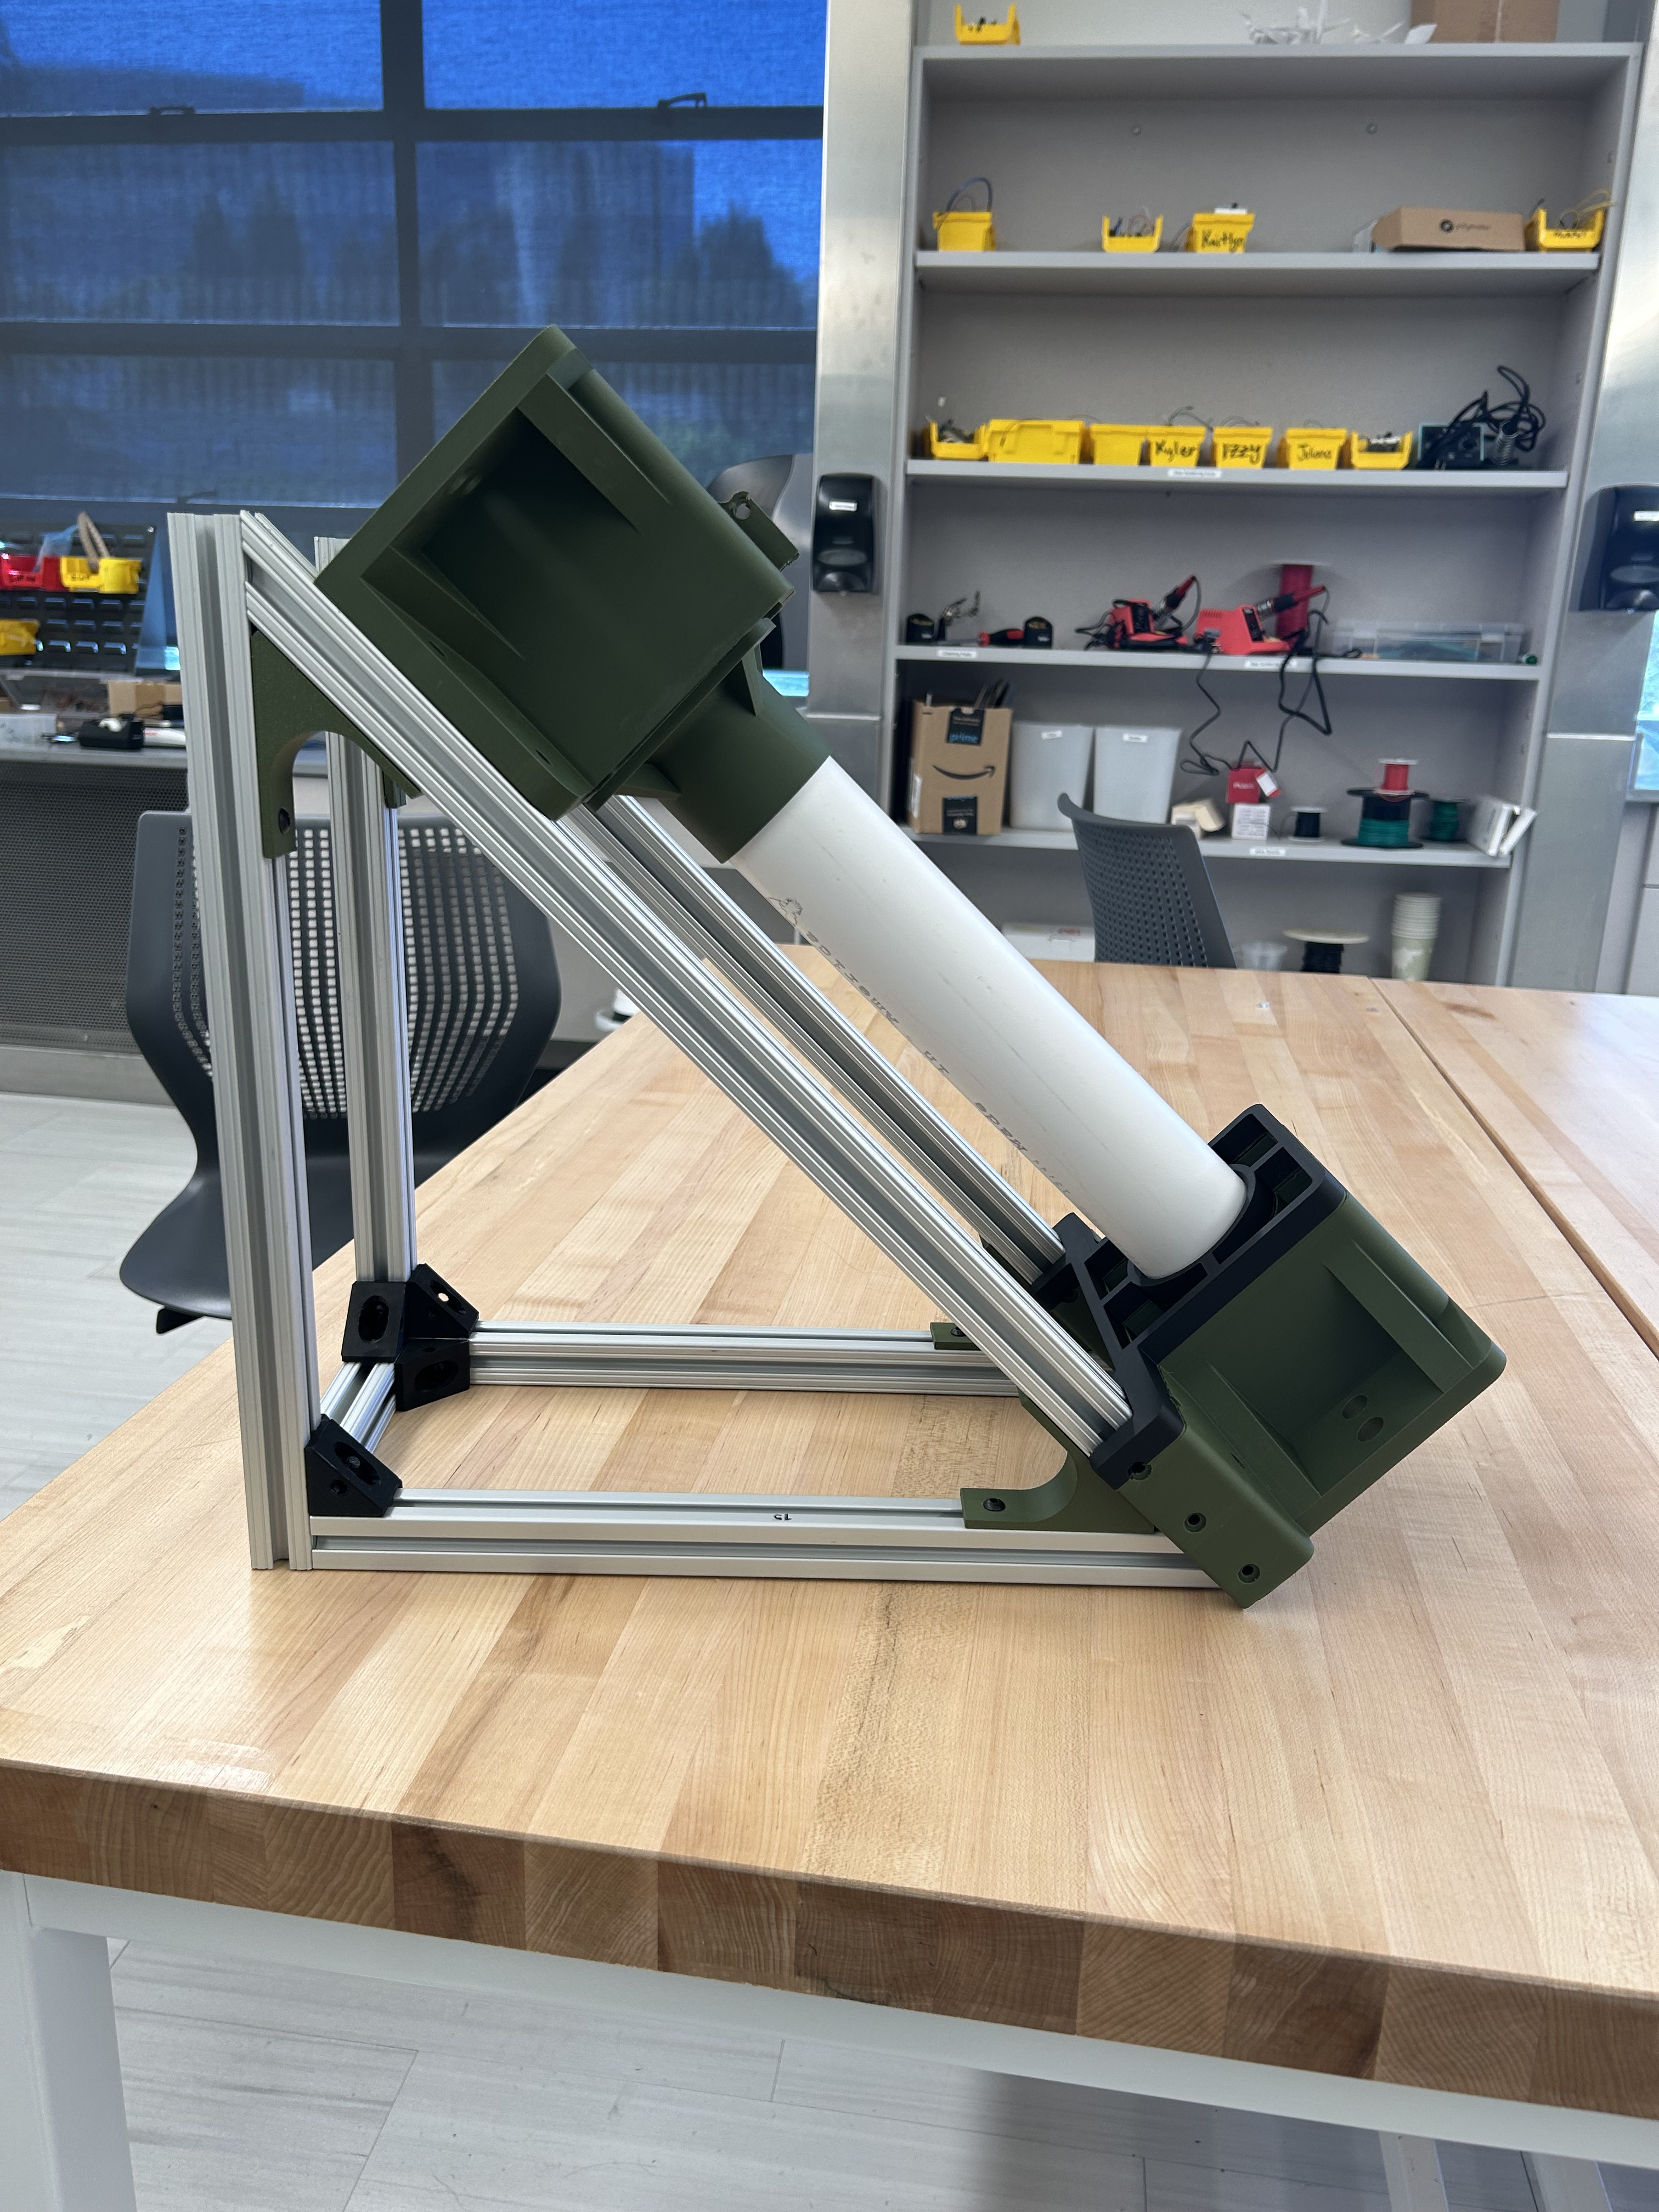
CURRENT PROTOTYPE
Notes:
We developed our current prototype focusing on these challenges.
One major change was eliminating the adjustable angle mount. Instead, we fixed the launcher angle at 45˚. This simplified operation and improved shot repeatability.
To address the friction issues in the original design, we switched to a PVC pipe with a small end cap. This greatly reduced the contact area between piston and chamber and reduced friction.
We added guide rails to the piston base to constrain piston movement and maintain alignment throughout the launch stroke.
Although not shown in the prototype image, we also added structural braces at the upper connection points of the triangular frame. Early testing revealed alignment and twisting issues at these joints, and the braces significantly improved rigidity and alignment.
Overall, the current prototype is simpler, more stable, and easier to operate while still maintaining the accuracy and repeatability of the crossbow-style design.

Slide 7
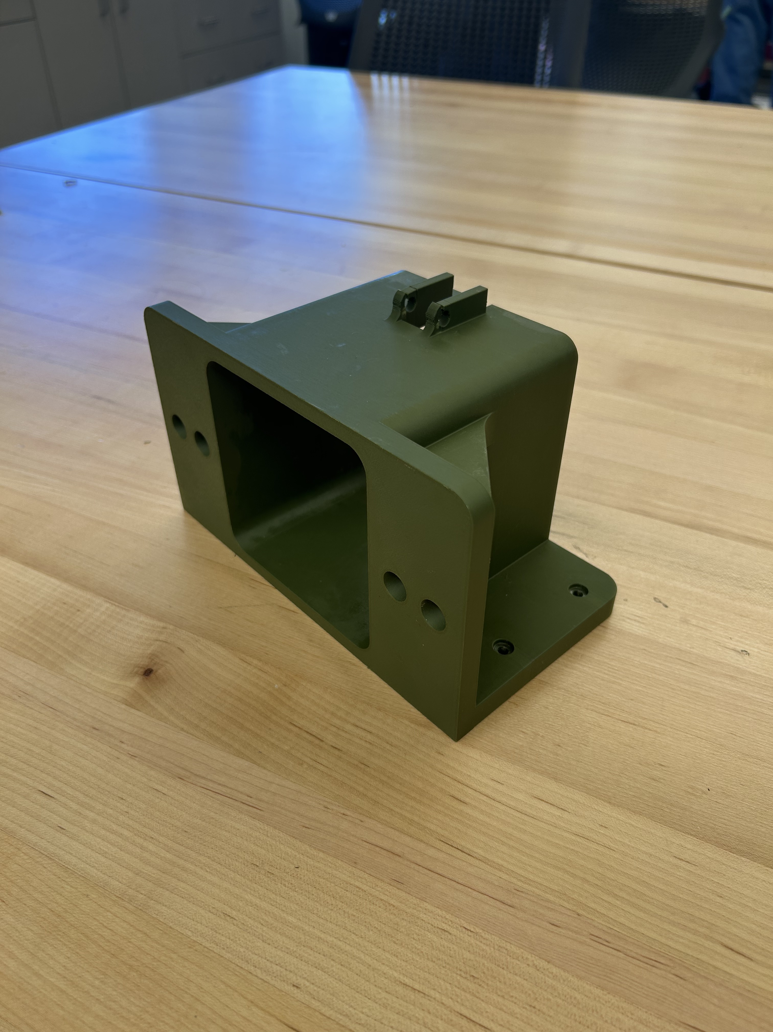
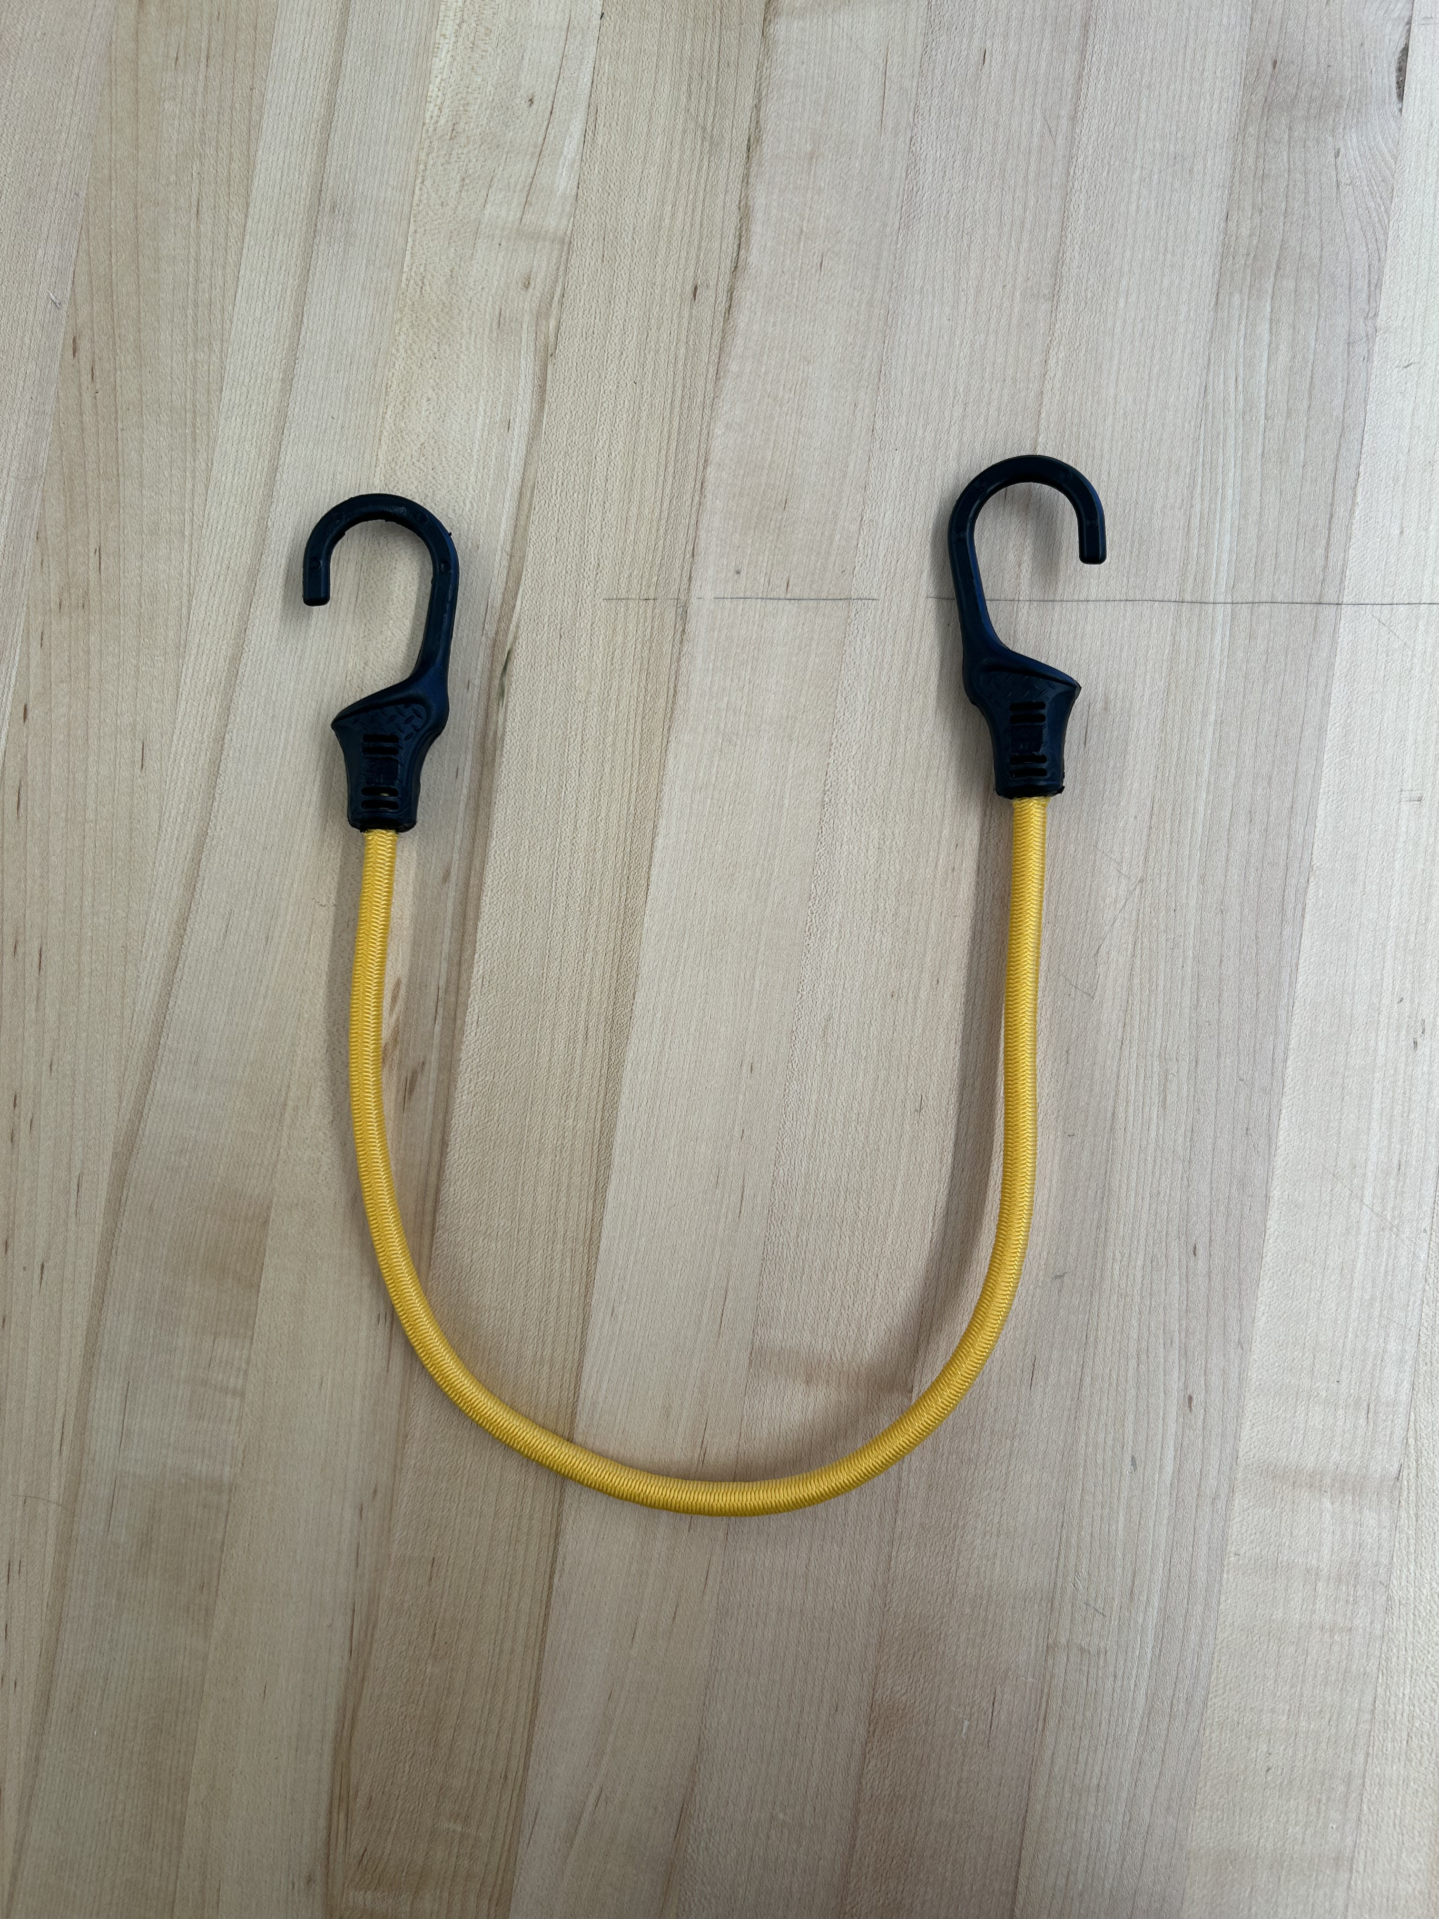
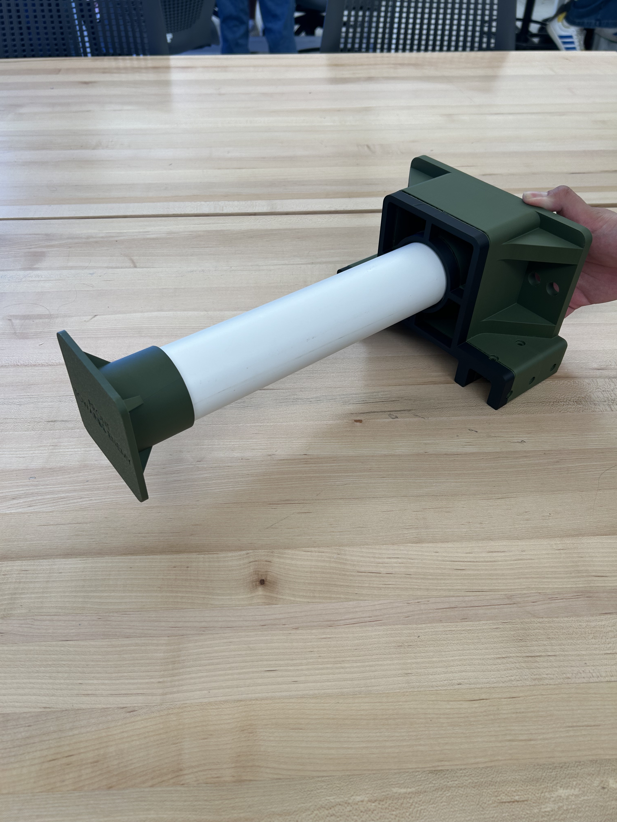
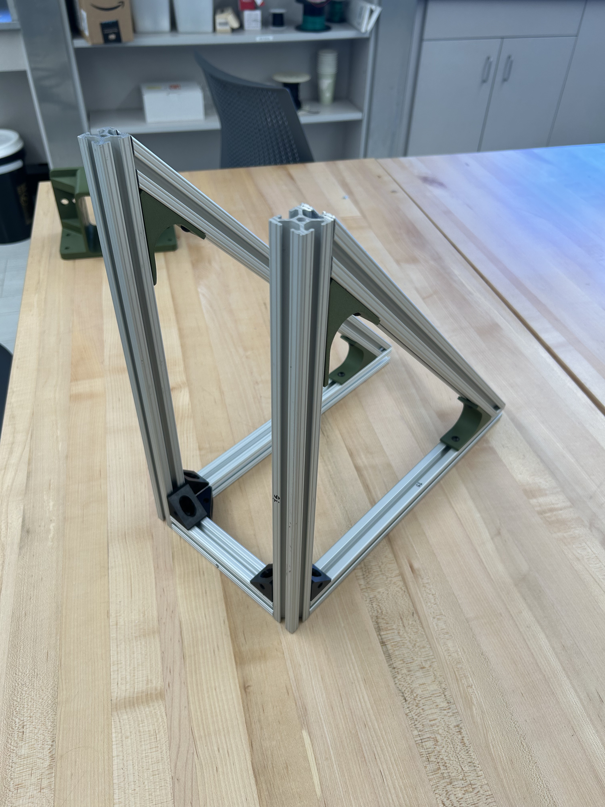
Analysis of sub-components
Chamber​​
Energy storage mechanism​
Piston
Chassis​​

Slide 8
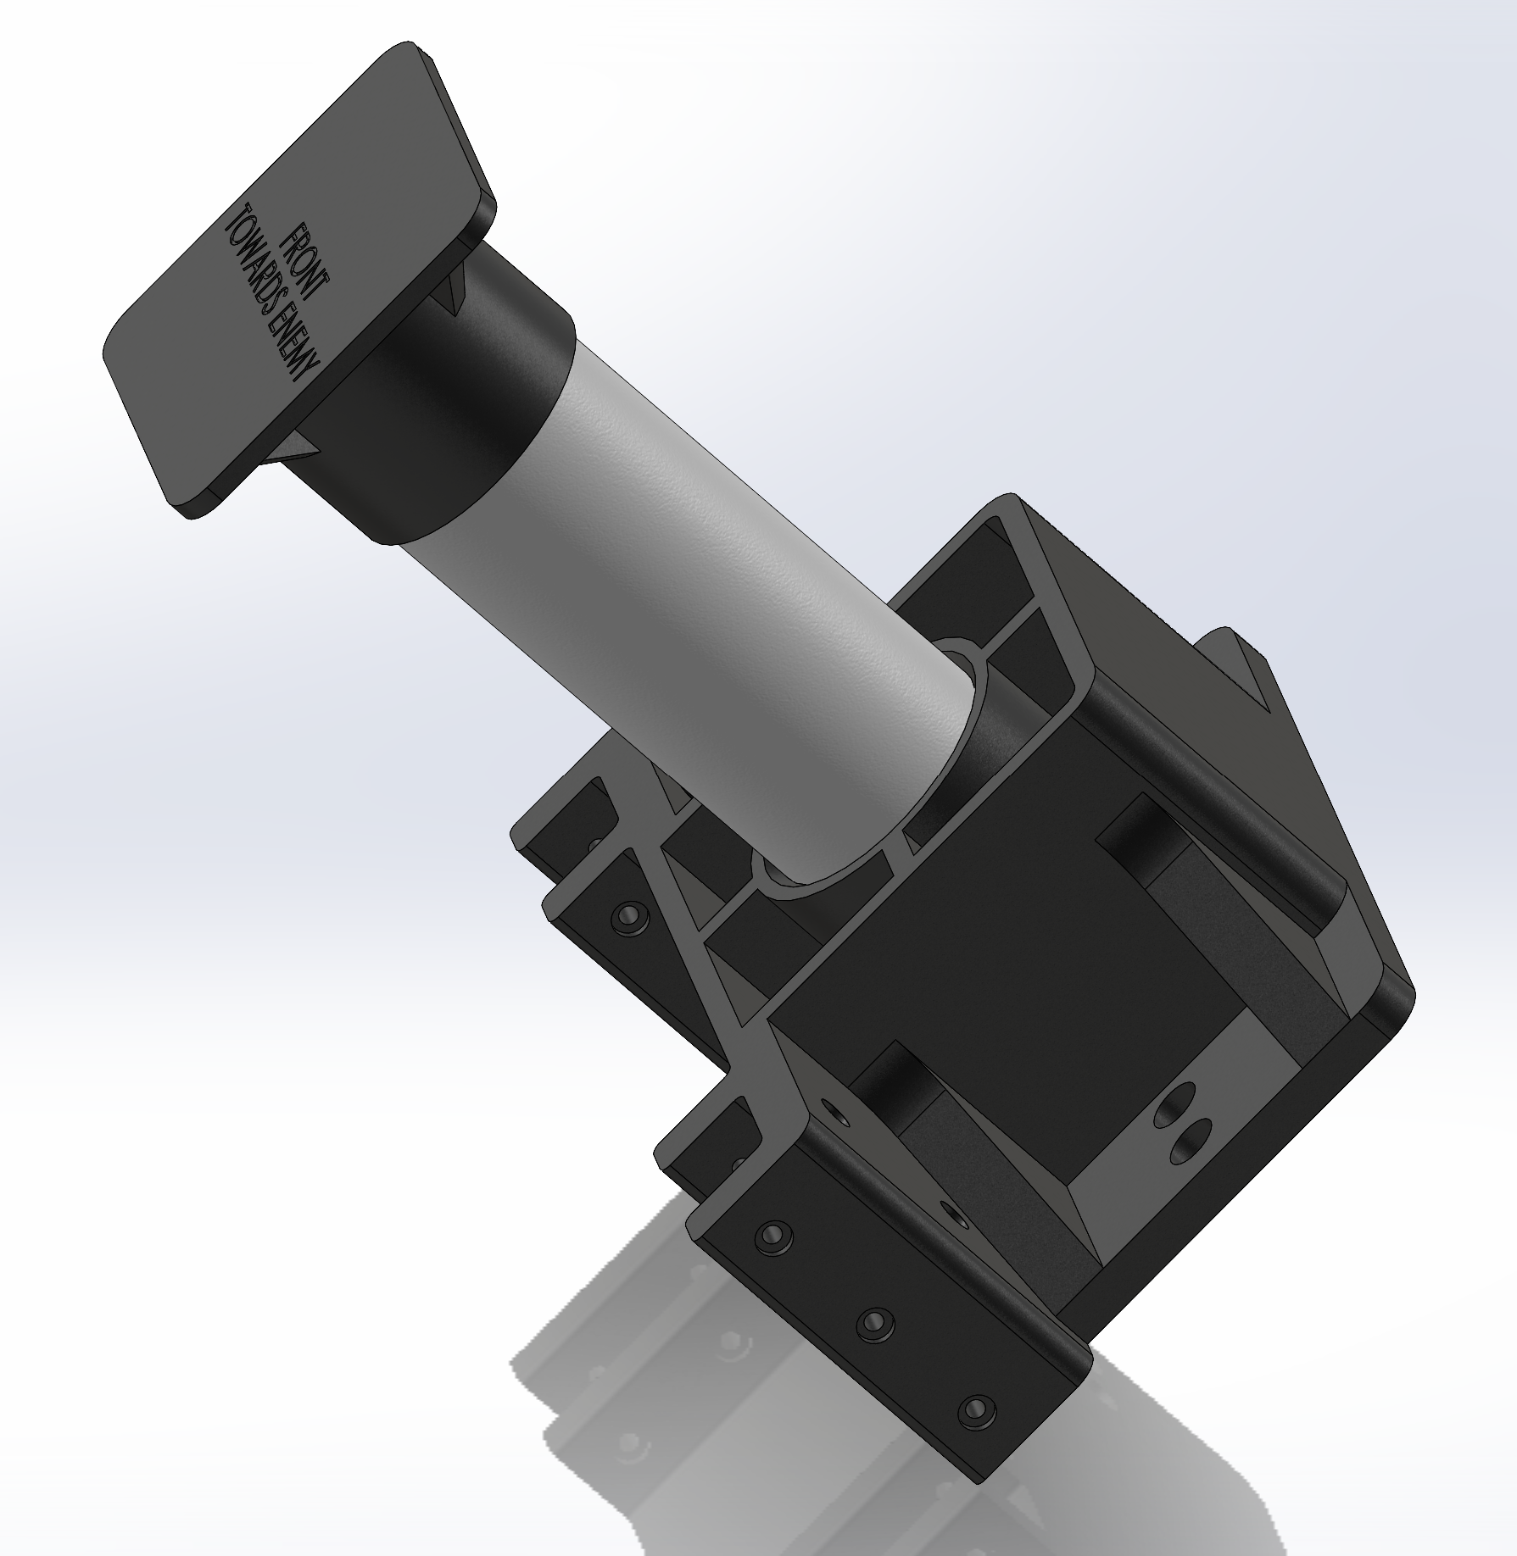
Piston Base + PVC + End Cap

Slide 9
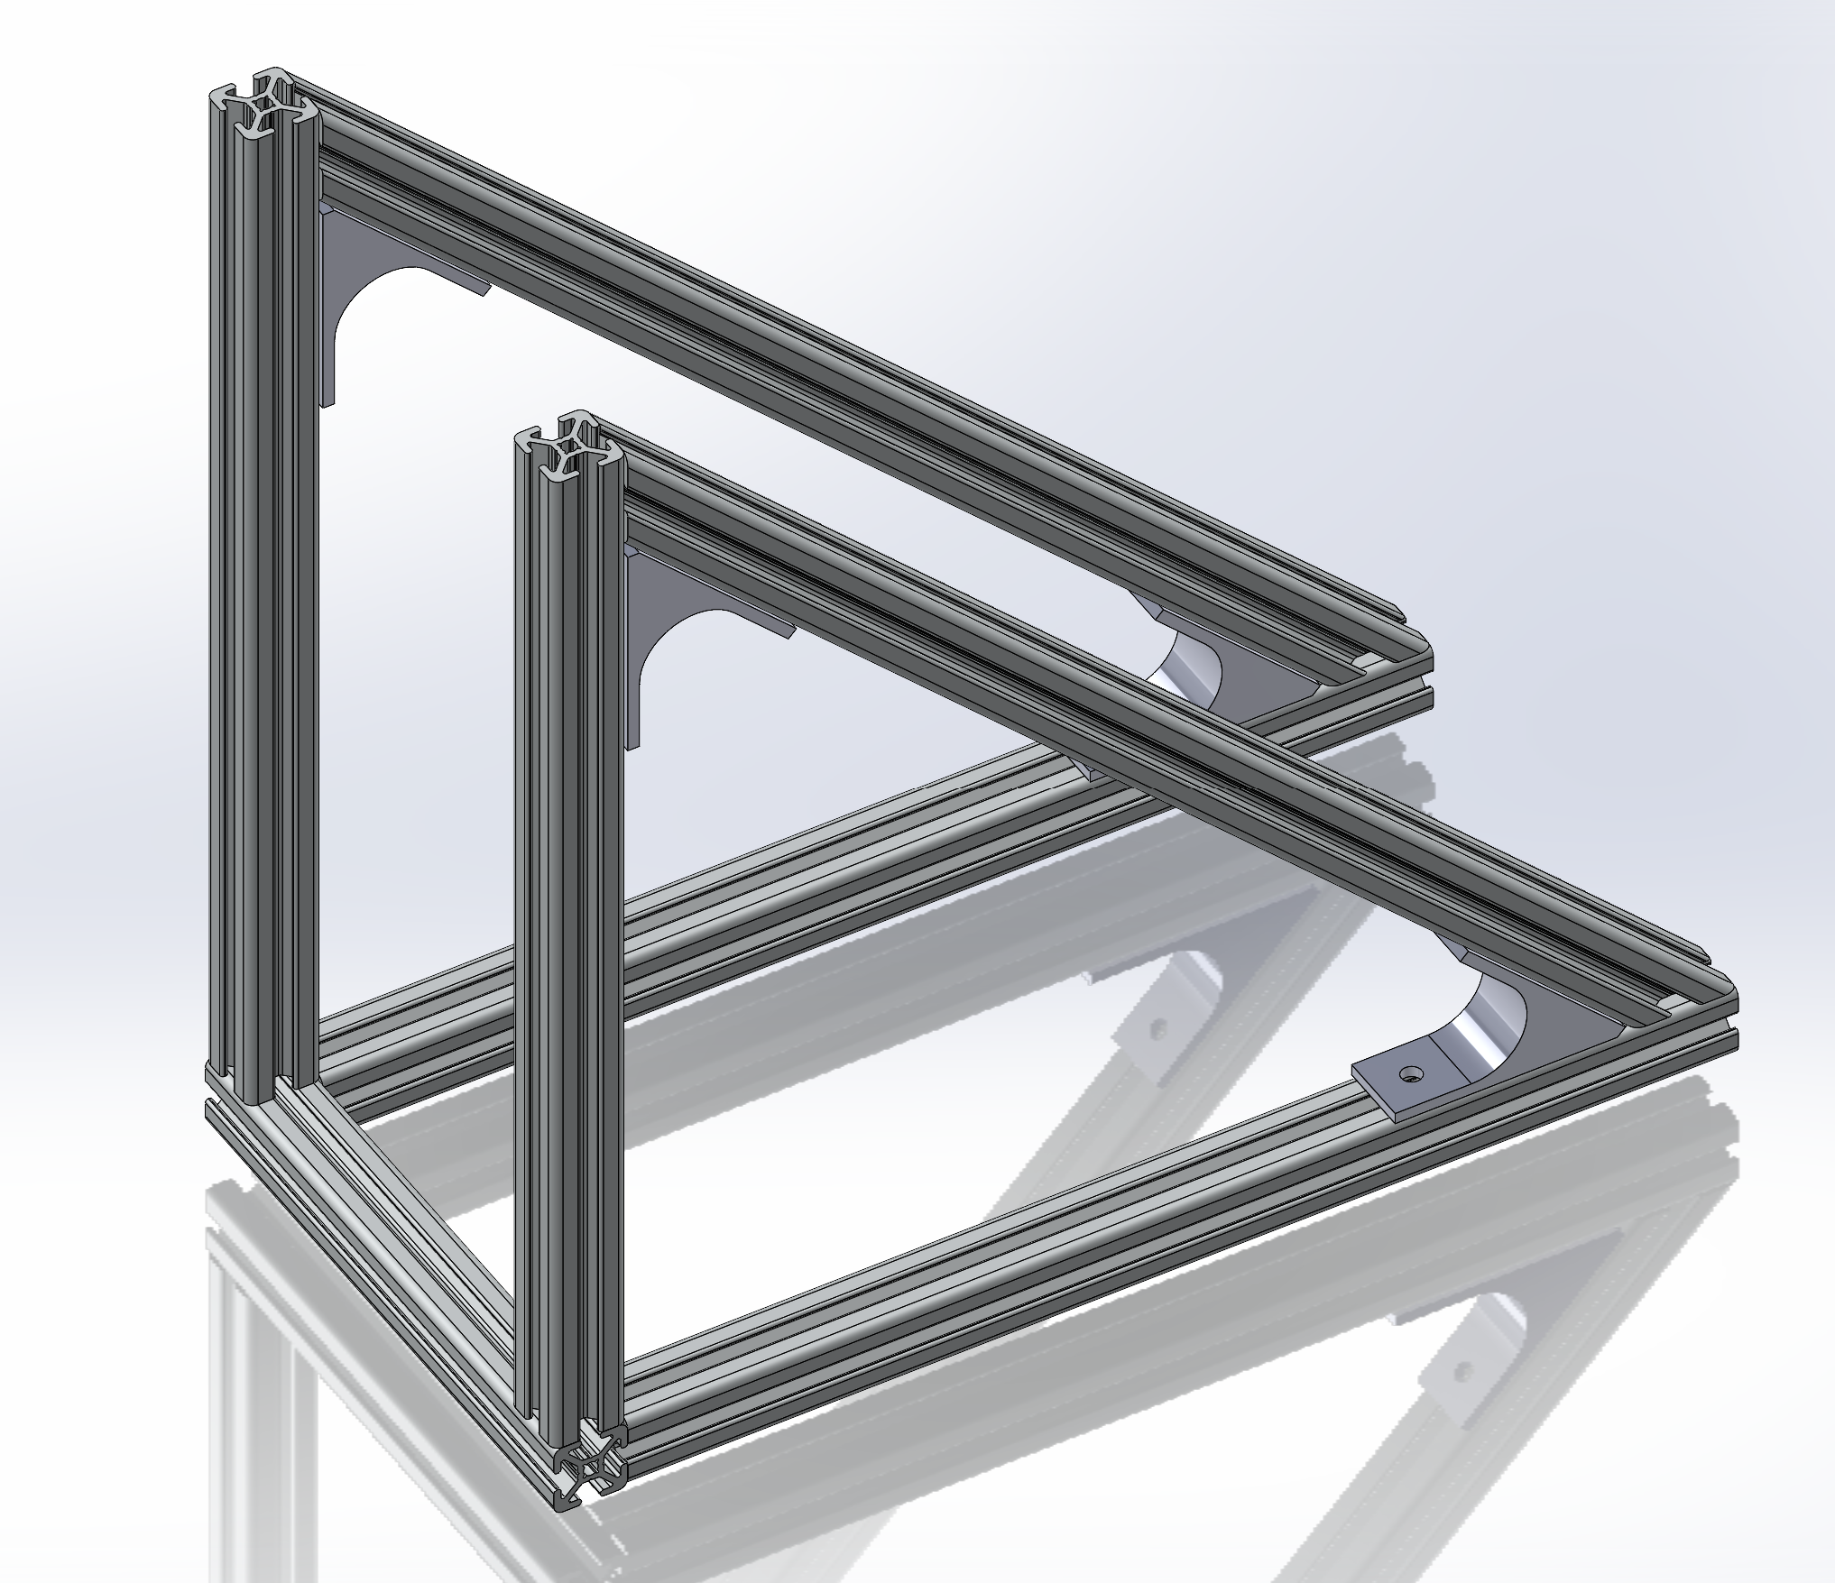
Frame + 45° Brackets

Slide 10
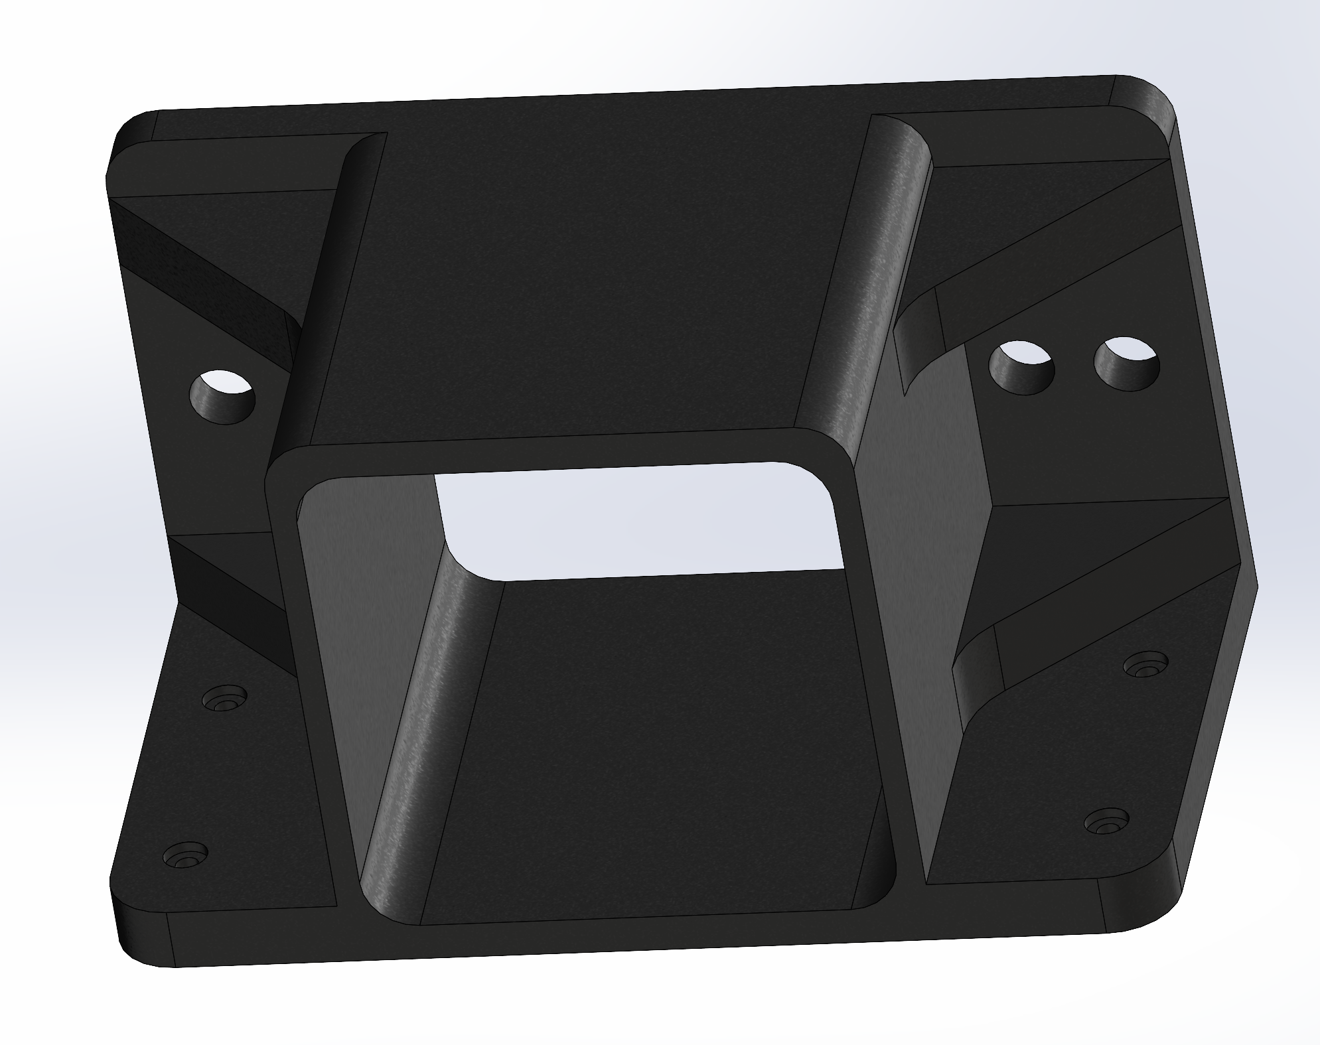
Chamber

Slide 11
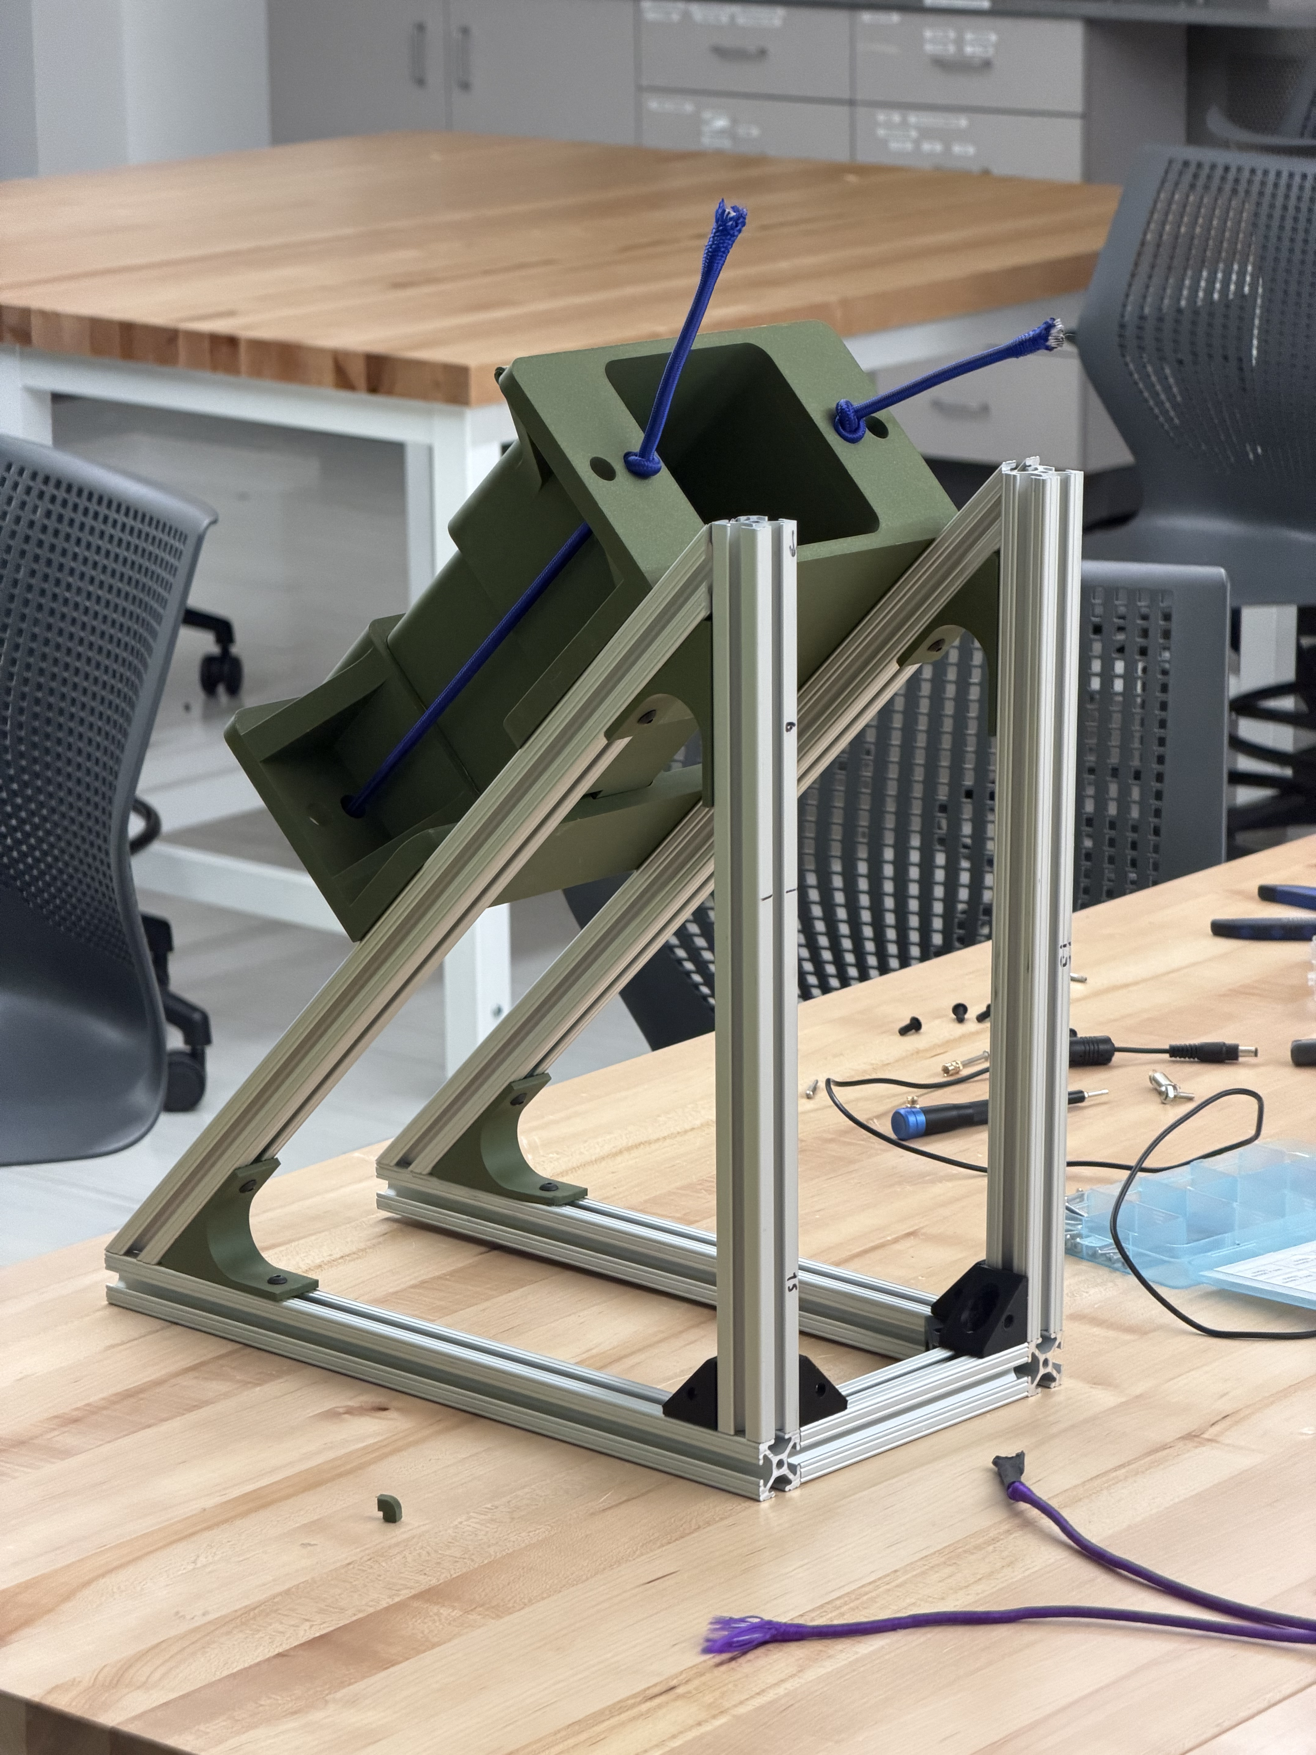
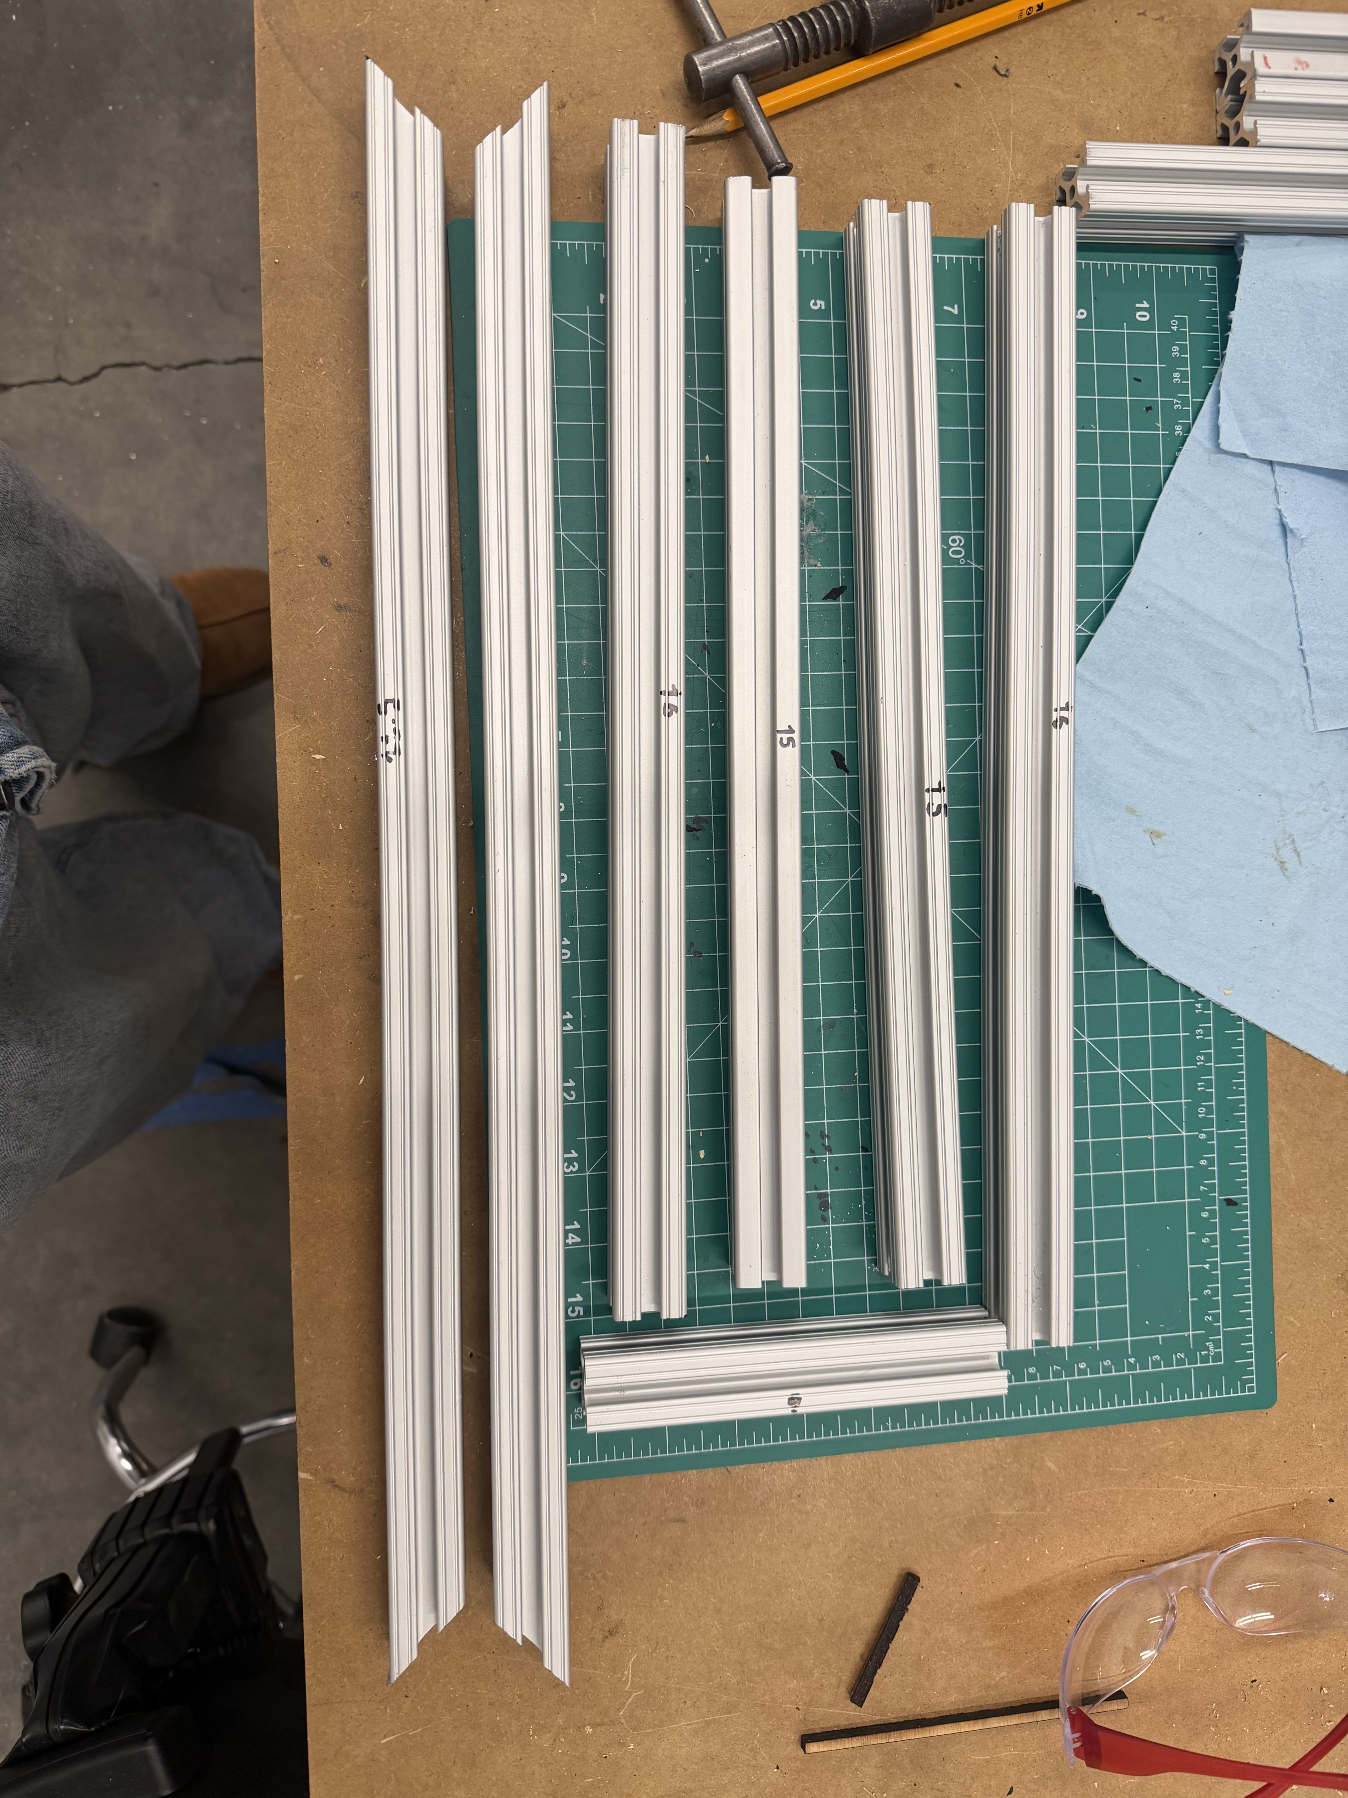
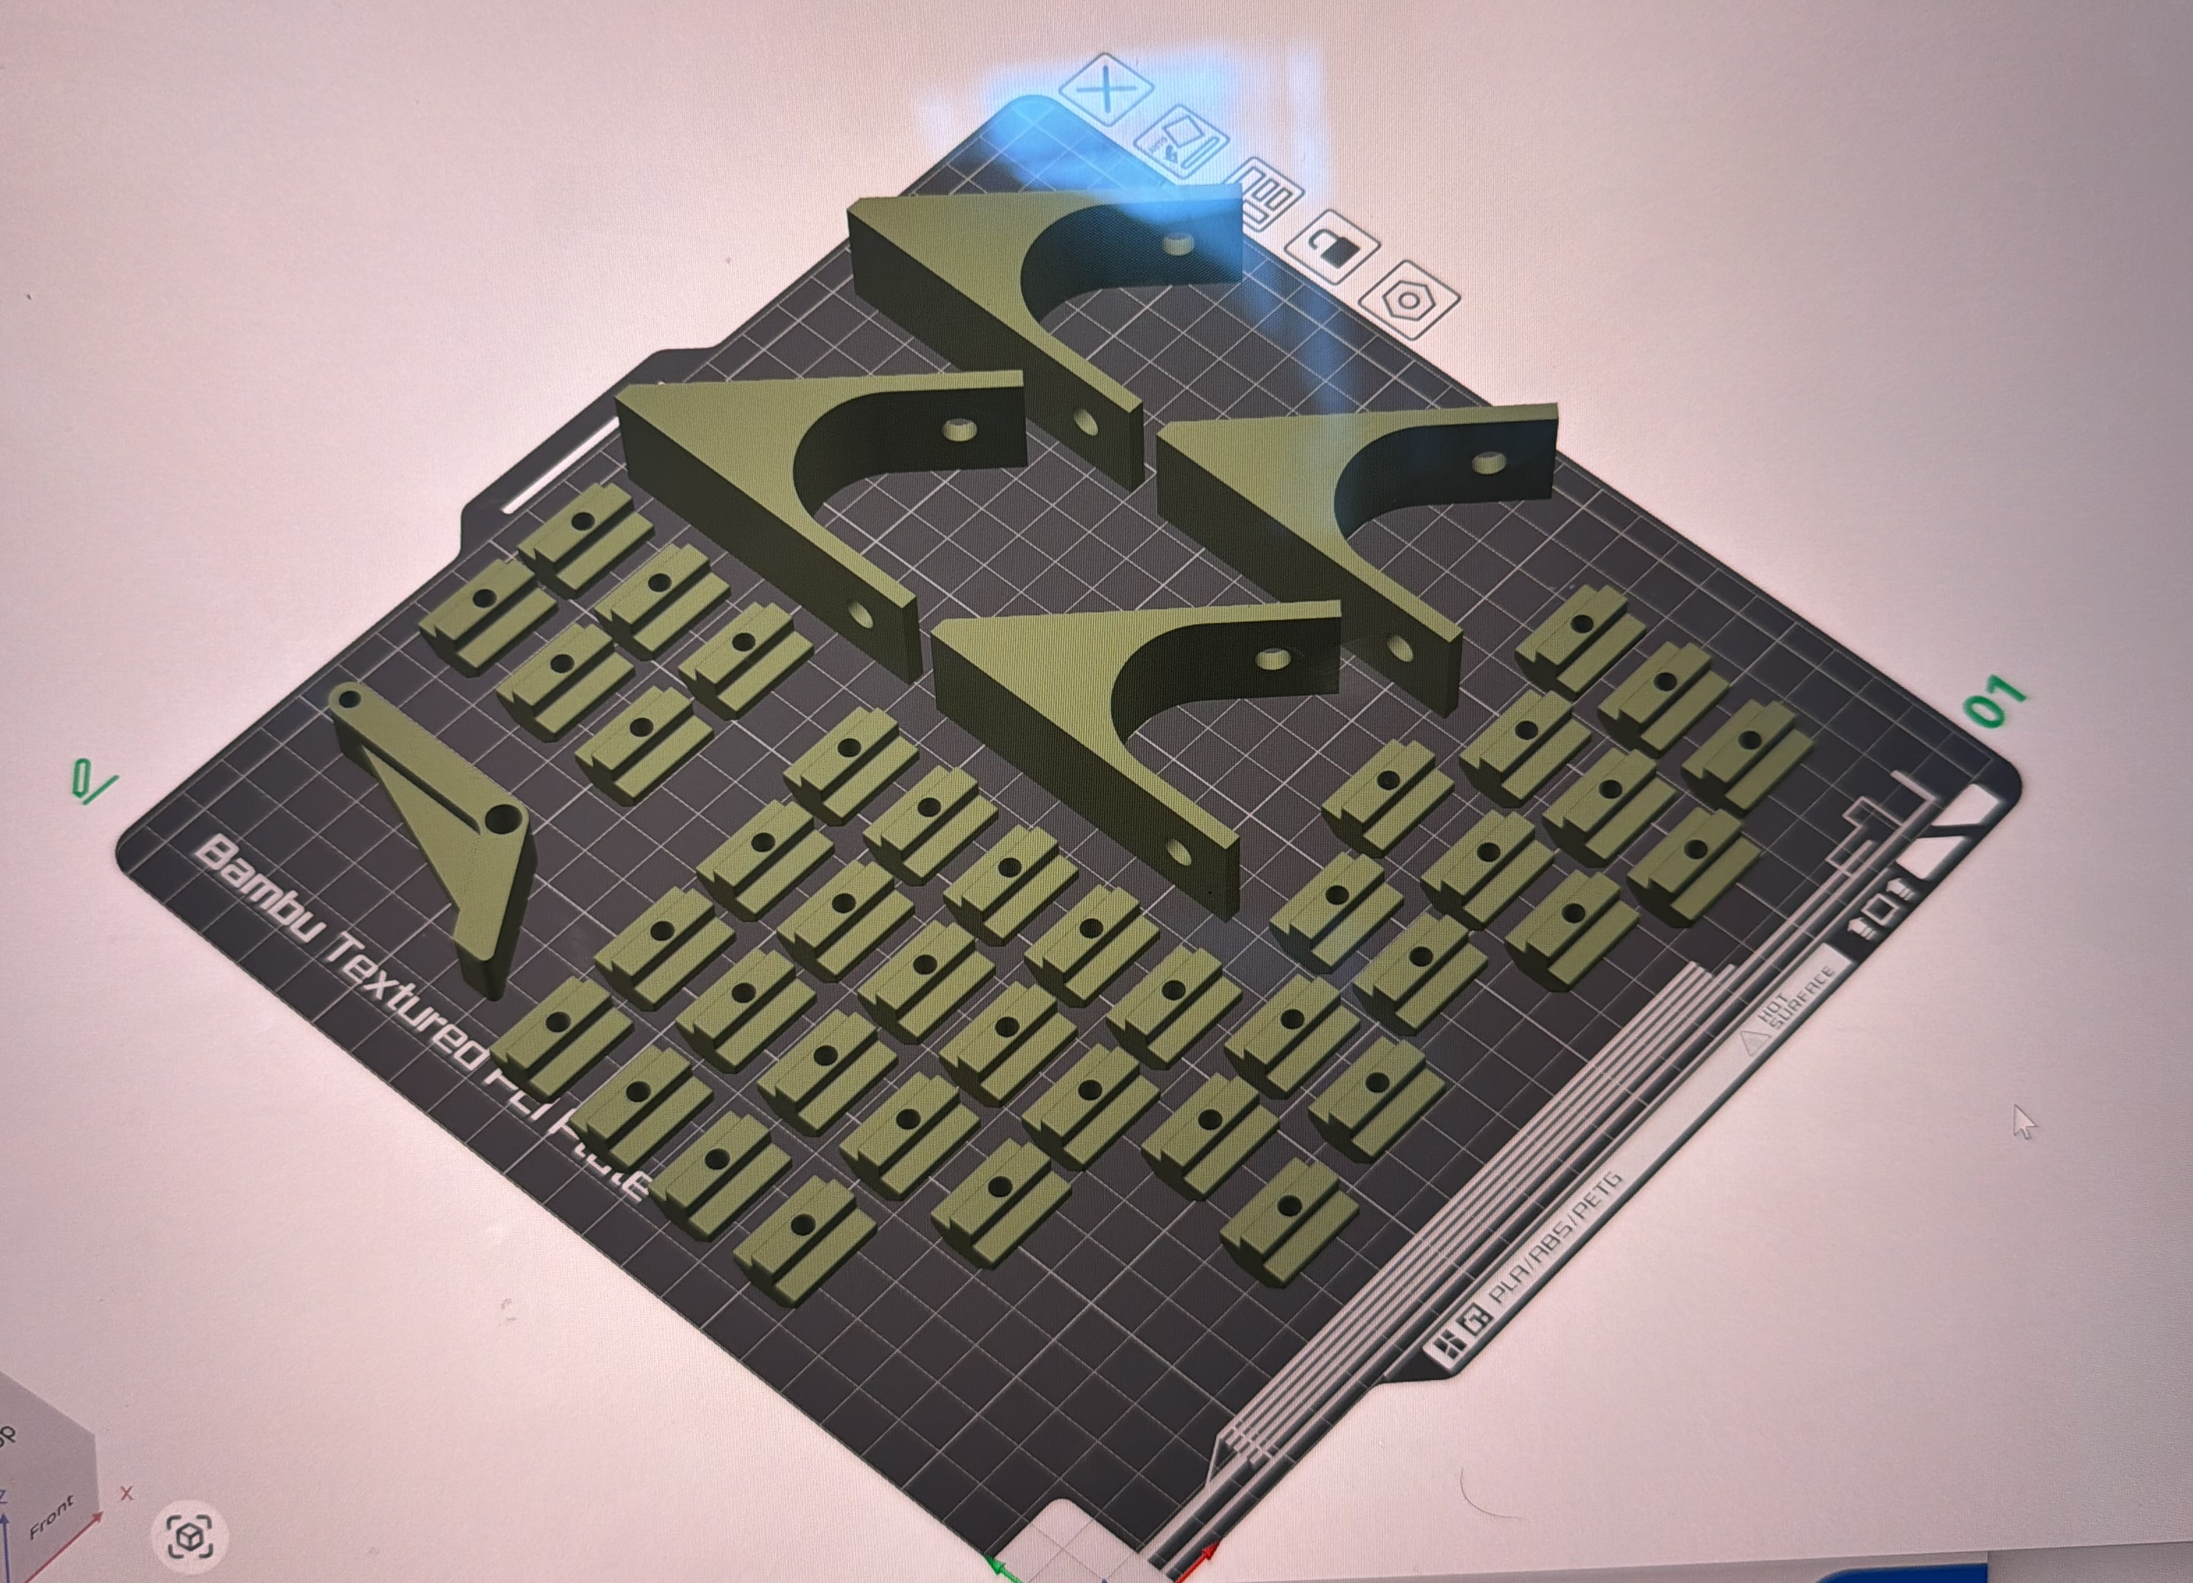
MANUFACTURING
CHALLENGES
COMPONENTS
OBJECTIVES

Slide 12
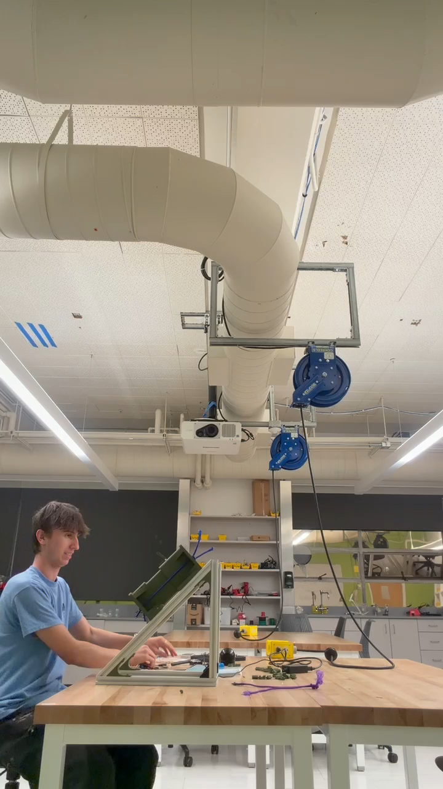
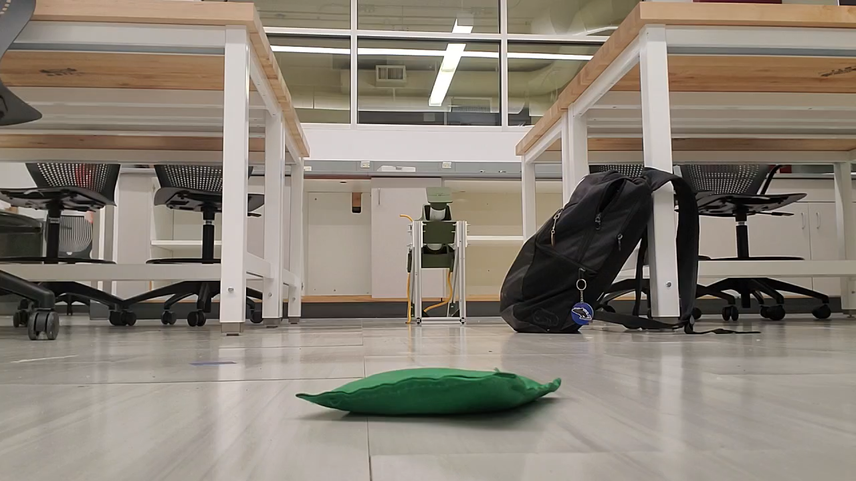
Initial launch tests

Slide 13
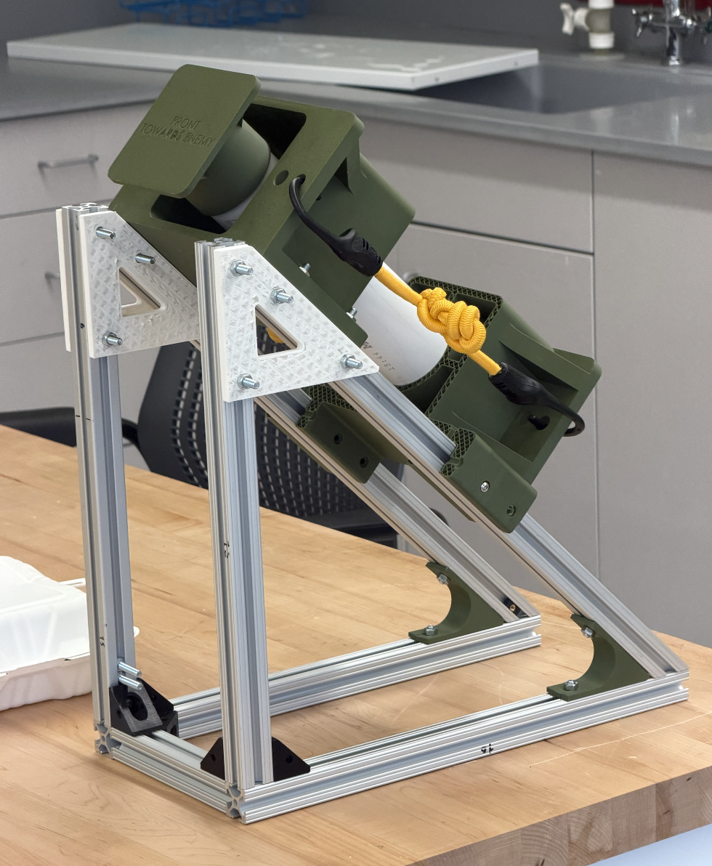
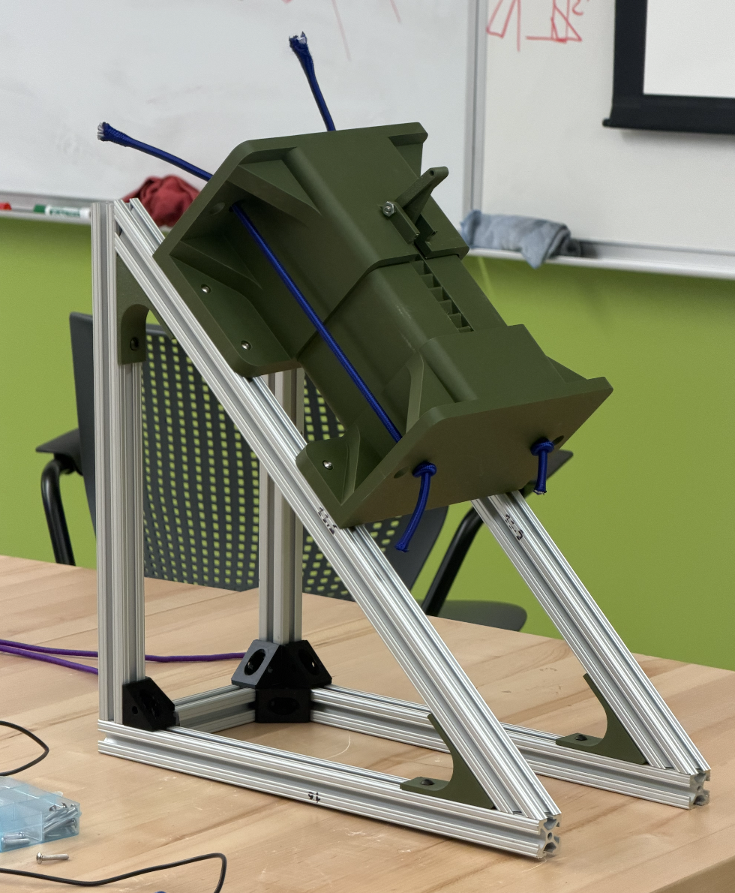
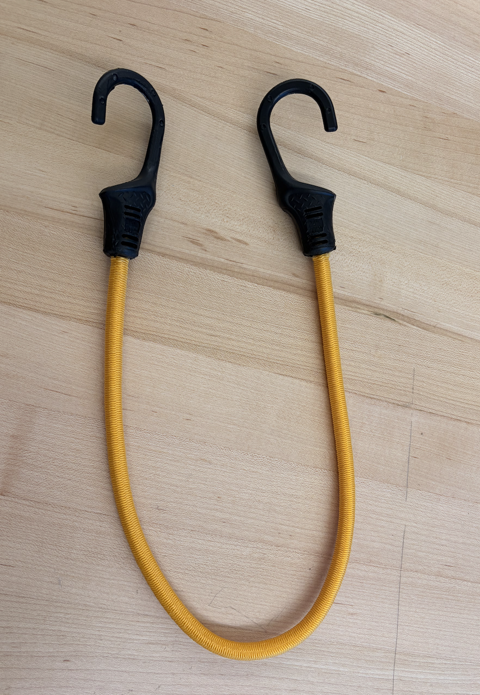
Preliminary testing
Issues and Solutions
Notes:
Alignment – not constraining enough movement
Brackets for stability
Friction
Failure from 3d printed piston
Switched to stronger material
Trigger snapped off
Bungee cord stretch distance
Replaced 3d printed piston with PVC pipe
Installed cap on top of pipe
Achieves the same result with far less problems
Acquired bungee cords with longer stretch distance

Slide 14
Estimated cost Analysis
COMPONENT | MATERIAL | $/Unit | PRICE
Chamber | PLA | $0.03/g | $9.09
Piston Shaft | PVC Pipe | $0.50/ft | $1.00​
Piston Housing | PLA | $0.03/g | $12.99
End Cap | PLA | $0.03/g | $1.86
Brackets | PLA | $0.03/g | $3.84
T-Slot Inserts | PLA | $0.03/g | $0.18
Energy Storage Mechanism | Bungee Cords | $0.20/ft | $0.20​
Chassis/Base​ | Aluminum Extrusions | $4.00/ft | $​36.48
Fasteners | Bolts/Nuts | $0.05/ea | $2.70
Total Expenses​ |  |  | $68.34

Slide 15
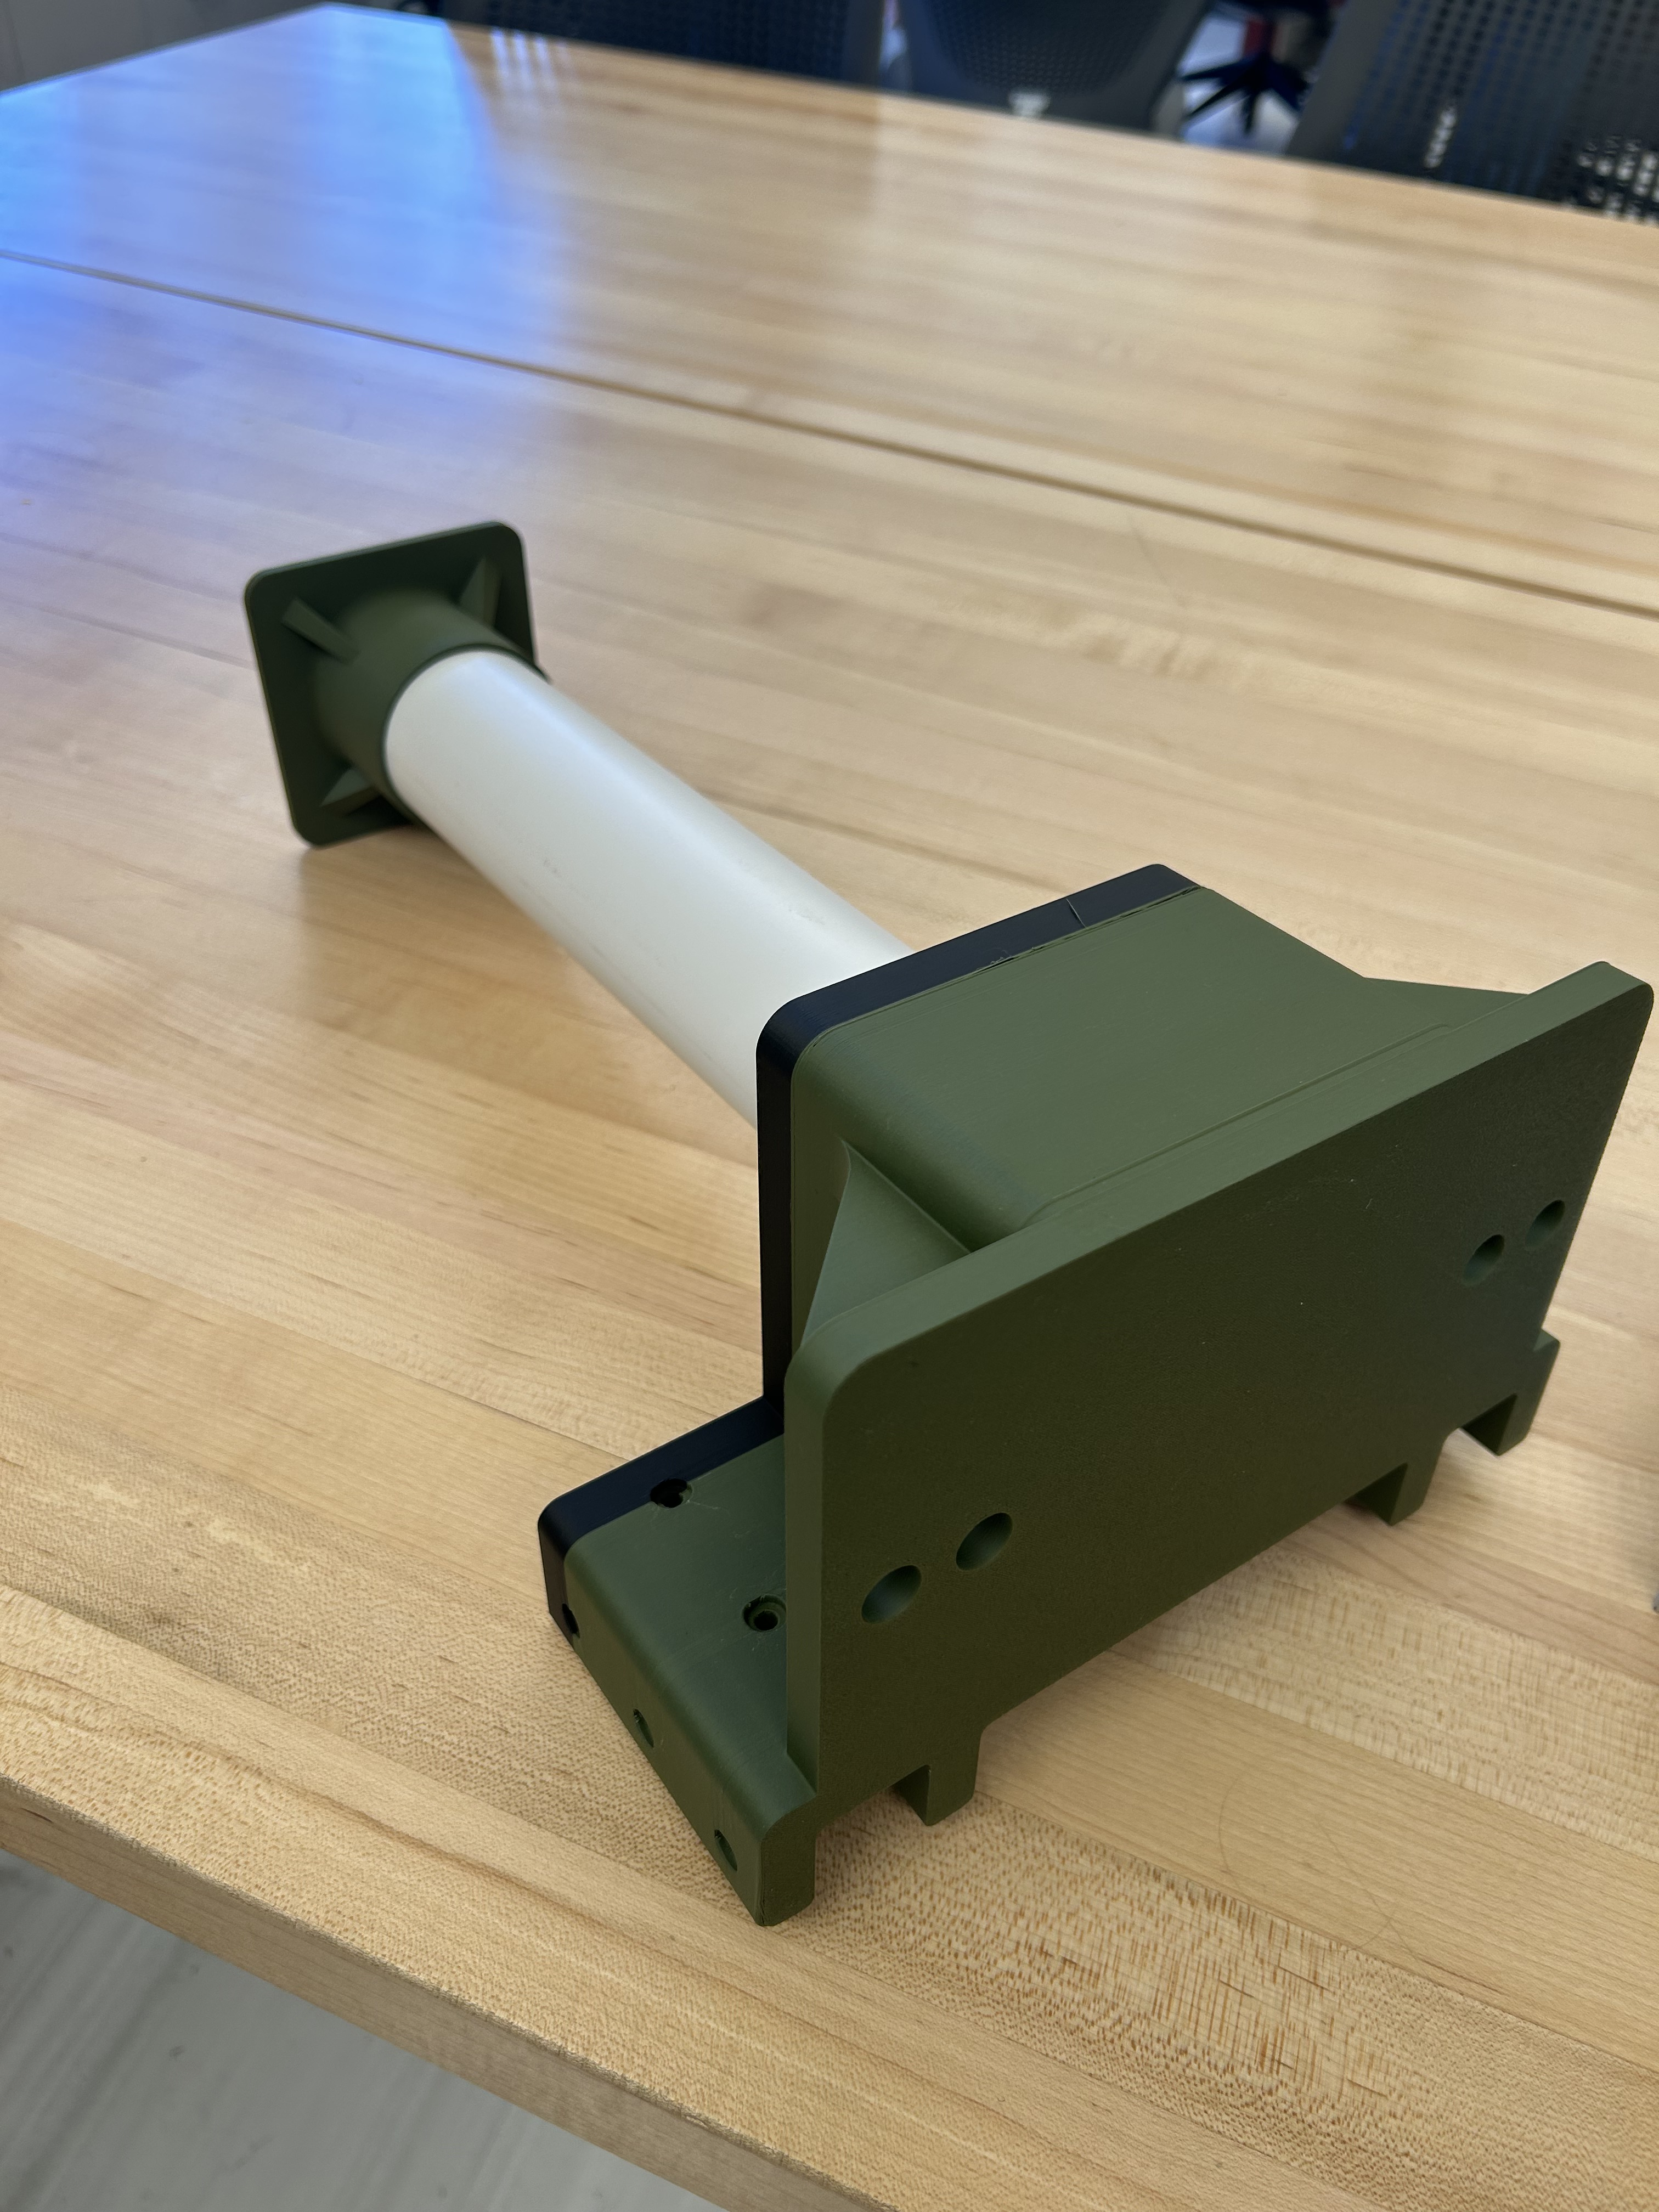
Plan for completion
Improve launch stroke
Create Progress saving mechanism
Improve DISTANCE
​

Slide 16
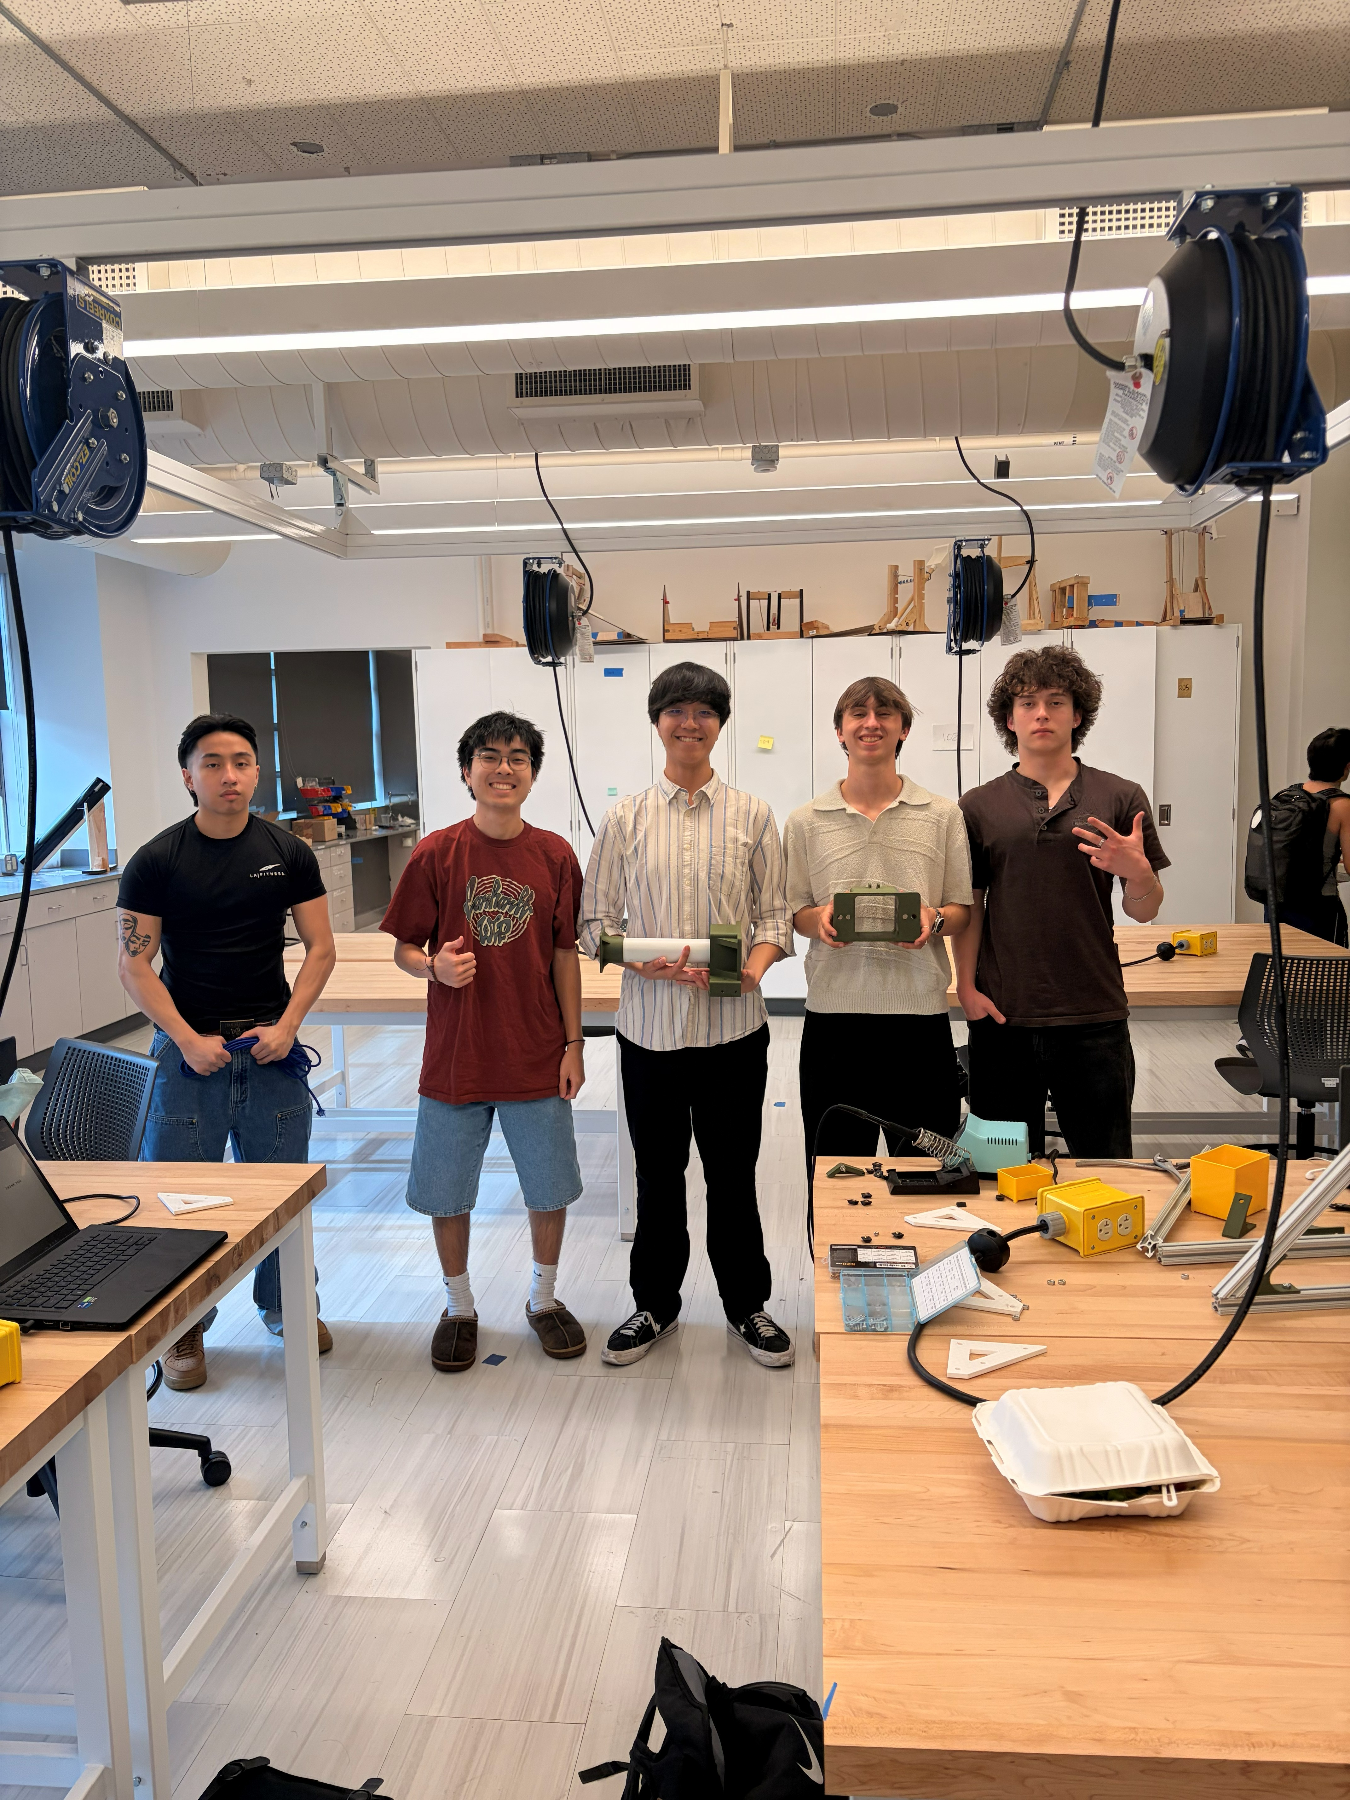
Thank You

